Slide 1
Module 8 System Hardening Baselining, Types of Attacks and Malicious Software Part 1

Slide 2
Module 8 Learning Objectives
On successful completion of this module, students should be able to:
describe how to harden operating systems and network operating systems
describe how to implement host-level security
describe how to harden applications
describe how to establish group policies
describe various types of computer and network attacks including denial of service, spoofing,
hijacking and password guessing
identify and describe the different types of malicious software – viruses, worms, trojan horses,
logic bombs, time bombs and rootkits
explain how social engineering can be used as a means to gain access to computers and networks
describe the importance of auditing and what should be done

Slide 3
Module 8 Learning Resources
Conklin et al. 2016, Principles of Computer Security: 4th edn.
The readings from the text for Module 8 are ‘Chapter 14 – System Hardening and Baselines’ pp. 408-463 and
‘Chapter 15 Types of attacks and malicious software’ pp. 464-503

Slide 4
Key Terms
Antispam
Antivirus (AV)
Application hardening
Application vulnerability scanner
Baseline
Baselining
Black listing
Firmware update
Globally unique identifier (GUID)
Group policy
Group policy object (GPO)
Hardening
Hardware security module (HSM)
Notes:
Antispam – Technology used to combat unsolicited junk e-mail, or spam.
Antivirus (AV) – Technology employed to screen for and block the execution of viruses and other malware.
Application hardening – The steps taken to harden an application, mitigating vulnerabilities and reducing the exploitable surface.
Application vulnerability scanner – Technology used to scan applications for potential vulnerabilities and weaknesses.
Baseline – A system or software as it is built and functioning at a specific point in time. Serves as a foundation for comparison or measurement, providing the necessary visibility to control change.
Baselining – The process of establishing a system’s security state.
Black listing – The term used to describe the exclusion of items based on their being on a list (black list).
Firmware update – An update process that occurs when small software is loaded onto internal nonvolatile RAM (NVRAM).
Globally unique identifier (GUID) – A unique reference number used as an identifier of an item in a system.
Group policy – The mechanism that allows for centralized management and configuration of computers and remote users in a Microsoft Active Directory environment.
Group policy object (GPO) – Stores the group policy settings in a Microsoft Active Directory environment.
Hardening – The process of strengthening a host level of security by performing specific system preparations.
Hardware security module (HSM) – A physical device used to protect but still allow use of cryptographic keys. It is separate from the host machine.

Slide 5
Key Terms (continued)
Heuristic scanning
Host vulnerability scanner
Hotfix
Network operating system (NOS)
Network segmentation
Network vulnerability scanner
Operating system (OS)
Patch
Patch management
Pluggable Authentication Modules (PAM)
Pop-up blocker
Process identifier (PID)
Notes:
Heuristic scanning – Scanning that does not rely on a virus dictionary. Instead, it looks for suspicious behavior—anything that does not fit into a “normal” pattern of behavior for the OS and applications running on the system being protected.
Host vulnerability scanner – A scanner designed to run on a specific host and look for vulnerabilities and misconfigurations on that host.
Hotfix – A set of updates designed to fix a specific problem.
Network operating system (NOS) – An operating system that includes additional functions and capabilities to assist in connecting computers and devices, such as printers, to a local area network.
Network segmentation – The separation of a network into separate addressable segments to limit network traffic traversal to areas of limited scope.
Network vulnerability scanner – The application of vulnerability scanning to network devices to search for vulnerabilities at the network level.
Operating system (OS) – The basic software that handles input, output, display, memory management, and all the other highly detailed tasks required to support the user environment and associated applications.
Patch – A replacement set of code designed to correct problems or vulnerabilities in existing software.
Patch management – A disciplined approach to the acquisition, testing, and implementation of OS and application patches.
Pluggable authentication modules (PAM) – A mechanism used in Linux systems to integrate low-level authentication methods into an API.
Pop-up blocker – A tool used to prevent web sites from opening additional web browser windows or tabs without specific user consent.
Process identifier (PID) – A unique identifier for a process thread in the operating system kernel.

Slide 6
Key Terms (continued)
Reference monitor
Runlevels
Security kernel
Security template
Service pack
Shadow file
TCP wrappers
Trusted Operating System
Trusted Platform Module (TPM)
White listing
Notes:
Reference monitor – A non-bypassable element of the kernel that processes and enforces all security interactions including subject object accesses.
Runlevels – In UNIX and Linux systems, runlevels indicate the type of state the system is in, from 0 (halted) to 6 (rebooting). Lower runlevels indicate maintenance conditions with fewer services running, higher runlevels are normal operating conditions. Each UNIX variant employs the concept in the same manner, but the specifics for each runlevel can differ.
Security kernel – A non-bypassable element of the kernel that processes and enforces all security interactions including subject object accesses. (See reference monitor.)
Security template – A collection of security settings that can be applied to a system.
Service pack – A large collection of fixes, corrections, and enhancements for an operating system, application, or group of applications.
Shadow file – The file that stores the encrypted password in a system.
TCP wrappers – A host-based networking ACL system, used in some Linux systems to filter network access to Internet Protocol servers.
Trusted Operating System – An OS that can provide appropriate levels of security and has mechanisms to provide assurance of security function.
Trusted Platform Module (TPM) – A hardware chip to enable trusted computing platform operations.
White listing – A listing of items to be allowed by specific inclusion. The opposite of black listing.

Slide 7
Introduction
The process of securing and preparing a system for the production environment is called hardening.
Hardening systems, servers, workstations, networks, and applications is a process of defining the required uses and needs and aligning security controls to limit a system’s desired functionality.
Once this is determined, you have a system baseline that you can compare changes to over the course of a system’s lifecycle.

Slide 8
Overview of Baselines
The process of establishing a system’s security state is called baselining.
The resulting product is a security baseline that allows the system to run safely and securely.
Once the process has been completed, any similar systems can be configured with the same baseline to achieve the same level of security and protection.
Uniform baselines are critical in large-scale operations.

Slide 9
Operating System and Network Operating System Hardening
The operating system (OS) of a computer is the basic software that handles things such as input, output, display, memory management, and all the other highly detailed tasks required to support the user environment and associated applications.
A network operating system (NOS) is an operating system that includes additional functions and capabilities to assist in connecting computers and devices.
Notes:
Most users are familiar with the Microsoft family of desktop operating systems: Windows Vista, Windows 7, Windows 8, and Windows 10. Indeed, the vast majority of home and business PCs run some version of a Microsoft operating system. Other users may be familiar with Mac OS X, Solaris, or one of the many varieties of the UNIX/Linux operating system.
Some of the more familiar network operating systems include Novell’s NetWare and PC Micro’s LANtastic. For most modern operating systems, including Windows 2008, Solaris, and Linux, the terms operating system and network operating system are used interchangeably as they perform all the basic functions and provide enhanced capabilities for connecting to LANs.

Slide 10
OS Security
The operating system itself is the foundation of system security.
The operating system does this through the use of a security kernel.
The security kernel is also called a reference monitor and is the component of the operating system that enforces the security policies of the operating system.
The core of the OS is constructed so that all operations must pass through and be moderated by the security kernel, placing the security kernel in complete control over the enforcement of rules.
Notes:
Security kernels must exhibit some properties to be relied upon: they must offer complete mediation, as just discussed, and must be tamperproof and verifiable in operation. Because they are part of the OS and are in fact a piece of software, ensuring that security kernels are tamperproof and verifiable is a legitimate concern.
To achieve assurance with respect to these attributes is a technical matter that is rooted in the actual construction of the OS and technically beyond the level of this book.

Slide 11
OS Security (continued)
Protection rings were devised in the Multics operating system in the 1960s, to deal with security issues associated with timesharing operations.
Protection rings can be enforced by hardware, software, or a combination, and serve to act as a means of managing privilege in a hierarchical manner.
Use of rings separates elements such as applications from directly interfacing with the hardware without going through the OS and, specifically, the security kernel.
Notes:
Ring 0 is the level with the highest privilege and is the element that acts directly with the physical hardware (CPU and memory). Higher levels, with less privilege, must interact through adjoining rings through specific gates in a predefined manner.

Slide 12
Host Security
Most environments are filled with different operating systems (Windows, Linux, OS X), different versions of those operating systems, and different types of installed applications.
Today, host-based security for mobile device operating systems is an important security issue.
Ensuring that every computer is “locked down” to the same degree as every other system in the environment can be overwhelming and often results in an unsuccessful and frustrating effort.
Notes:
Each operating system has security configurations that differ from other systems, and different versions of the same operating system may in fact have variations between them.
Host security is important and should always be addressed. Security, however, should not stop there, as host security is a complementary process to be combined with network security. If individual host computers have vulnerabilities embodied within them, then network security can provide another layer of protection that will, hopefully, stop any intruders who have gotten that far into the environment.

Slide 13
Machine Hardening
The key management issue behind running a secure server setup is to identify the specific needs of a server for its proper operation and enable only items necessary for those functions.
Reducing the attack surface area associated with a server reduces the vulnerabilities now and in the future as updates are required.
Once a server has been built and is ready to be placed into operation, the recording of hash values on all of its crucial files will provide valuable information later.
Notes:
Keeping all other services and users off the system improves system throughput and increases security.
The use of hash values to detect changes was first developed by Gene Kim and Eugene Spafford at Purdue University in 1992. The concept became the product Tripwire, which is now available in commercial and open source forms. The same basic concept is used by many security packages to detect file-level changes.
The primary method of controlling the security impact of a system on a network is to reduce the available attack surface area. Turning off all services that are not needed or permitted by policy will reduce the number of vulnerabilities. Removing methods of connecting additional devices to a workstation to move data—such as optical drives and USB ports—assists in controlling the movement of data into and out of the device. User-level controls, such as limiting e-mail attachment options, screening all attachments at the e-mail server level, and reducing network shares to needed shares only, can be used to limit the excessive connectivity that can impact security.

Slide 14
Operating System Security and Settings
Operating systems are complex programs designed to provide a platform for a variety of services to run.
Some services are extensions of the OS itself, while others are standalone applications using the OS as a mechanism to connect to programs and hardware resources.
It is up to the OS to manage the security aspects of the hardware being utilized.
Determining the correct settings and implementing them correctly is an important step in securing a host system.

Slide 15
OS Hardening
System hardening has several key requirements.
The base installation of all OS and application software comes from a trusted source, and is verified as correct by using hash values.
Machines are connected only to a completely trusted network during the installation, hardening, and update processes.
The base installation includes all current service packs and updates for both the OS and applications.
Current backup images are taken after hardening and updates to facilitate system restoration to a known state.
Notes:
You must meet several key requirements to ensure that the system hardening processes described in this section achieve their security goals.
These steps ensure that you know what is on the machine, can verify its authenticity, and have an established backup version.

Slide 16
Hardening Microsoft Operating Systems
Hardening Windows
With the release of Windows Vista, Microsoft tried to make similar security improvements to its mainstream desktop OS as it did to its main server OS, Windows 2003.
As a desktop OS, Windows has provided a range of security features for users to secure their systems.
Most of these options can be employed via group policies in enterprise setups, making them easily deployable and maintainable across an enterprise.
Notes:
Here are some of the security capabilities introduced with Vista and continued in later versions of Windows:
■ User Account Control allows users to operate the system without requiring administrative privileges. If you’ve used Windows Vista and beyond, you’ve undoubtedly seen the “Windows needs your permission to continue” pop-ups. While annoying to many users (one of Apple’s “I’m a Mac” commercials focused specifically on this feature), this feature does help prevent users from “accidentally” making changes to their system configuration. Figure 14.1 shows the User Account Control feature in Windows 7.
■ Windows Firewall includes an outbound filtering capability. Windows allows filtering of traffic coming into and leaving the system, which is useful for controlling things like peer-to-peer applications.
■ BitLocker allows encryption of all data on a server, including any data volumes. This capability is only available in the higher-end distributions of Windows.
■ Windows clients work with Network Access Protection. See the discussion of NAP in the following “Hardening Windows Server 2008” section for more details.
■ Windows Defender is a built-in malware detection and removal tool. Windows Defender detects many types of potentially suspicious software and can prompt the user before allowing applications to make potentially malicious changes.

Slide 17
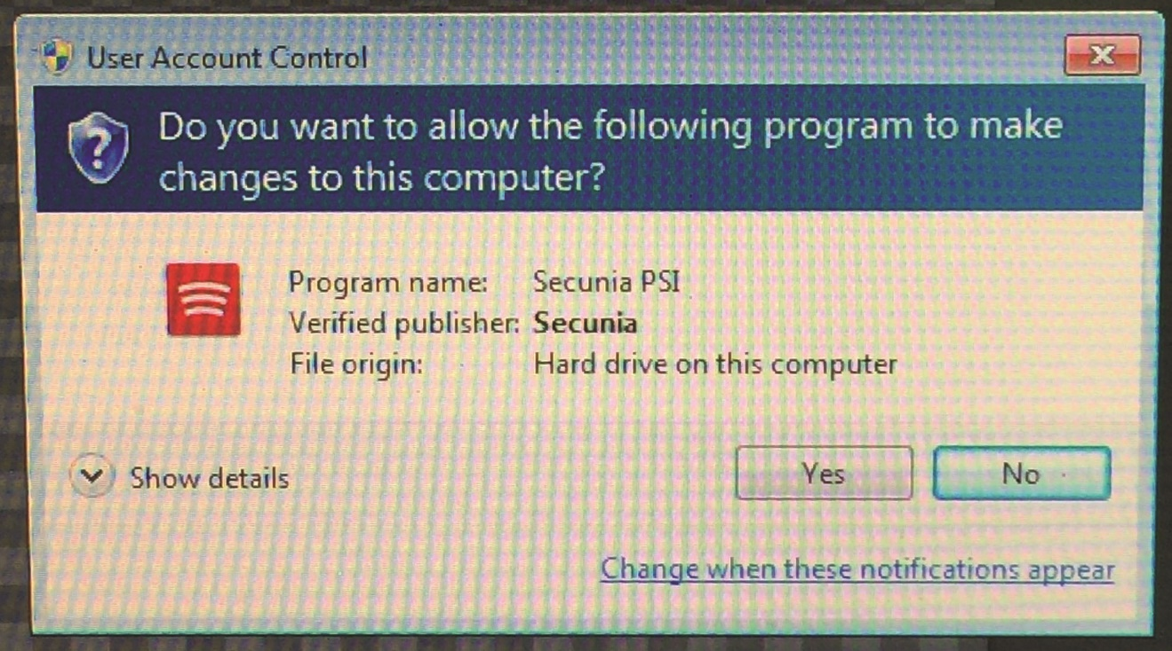
Figure 14.1 Windows 7 User Account Control in action
Notes:
Figure 14.1 shows the User Account Control feature in Windows 7.

Slide 18
Hardening Windows Server 2008
Microsoft touted Windows Server 2008 as its “most secure server” to date upon its release.
Building on the changes it made to the Windows Server 2003 and Vista OSs, Microsoft attempted to add more defense-in-depth protections to Windows Server 2008.
Microsoft has a free hardening guide for the Windows Server 2008 OS from its Download Center.
Notes:
Here are some of the new security capabilities that were introduced in Windows Server 2008:
■ BitLocker allows encryption of all data on a server, including any data volumes. This capability is also available in certain versions of Vista (and beyond).
■ Role-based installation of functions and capabilities minimizes the server’s footprint. For example, if a server is going to be a web server, it does not need DNS or SMTP software, and thus those features are no longer installed by default.
■ Network Access Protection (NAP) controls access to network resources based on a client computer’s identity and compliance with corporate governance policy. NAP allows network administrators to define granular levels of network access based on client identity, group membership, and the degree to which that client is compliant with corporate policies. NAP can also ensure that clients comply with corporate policies. Suppose, for example, that a sales manager connects her laptop to the corporate network. NAP can be used to examine the laptop and see if it is fully patched and running a company-approved antivirus product with updated signatures. If the laptop does not meet those standards, network access for that laptop can be restricted until the laptop is brought back into compliance with corporate standards.
■ Read-only domain controllers can be created and deployed in high-risk locations, but they can’t be modified to add new users, change access levels, and so on. This new ability to create and deploy “read-only” domain controllers can be very useful in high-threat environments.
■ More-granular password policies allow for different password policies on a group or user basis. This allows administrators to assign different password policies and requirements for the sales group and the engineering group if that capability is needed.
■ Web sites or web applications can be administered within IIS 7. This allows administrators quicker and more convenient administration capabilities, such as the ability to turn on or off specific modules through the IIS management interface. For example, removing CGI support from a web application is a quick and simple operation in IIS 7.

Slide 19
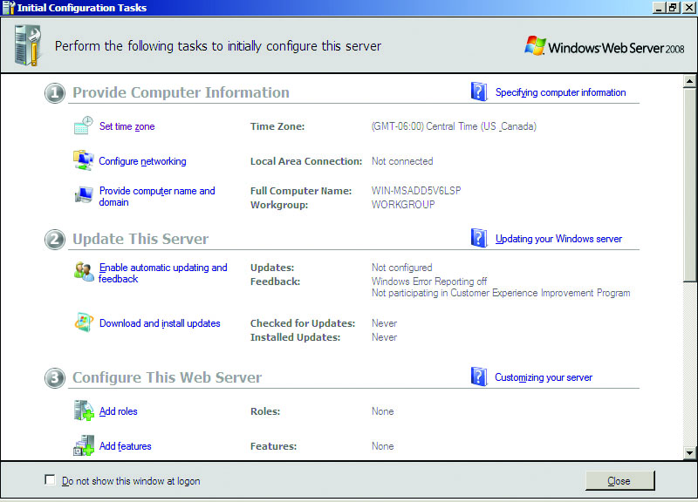
Figure 14.2 Windows 2008 Initial Configuration Tasks
Notes:
Figure 14.2 lists the initial configuration tasks for Windows 2008.

Slide 20
Hardening Windows Server 2012
With the release of Windows Server 2012, Microsoft added significant enhancements to its security baseline for its server line.
Windows 2012 R2 continued the security feature set through refinements and improvements across many of the security features.
The tools available in each subsequent release of the server OS are designed to increase the difficulty factor for attackers, eliminating known methods of exploitation.
Notes:
With the release of Windows Server 2012, Microsoft added significant enhancements to its security baseline for its server line:
■ Replaced the traditional ROM-BIOS with Unified Extensible Firmware Interface (UEFI). Microsoft is using the security-hardened 2.3.1 version, which prevents boot code updates without appropriate digital certificates and signatures.
■ Extended the trustworthy and verified boot process to the entire Windows OS boot code with a feature known as Secure Boot. UEFI and Secure Boot significantly reduce the risk of malicious code, such as rootkits and boot viruses.
■ Improved BitLocker functionality to allow administrator-less reboots.
■ Instituted Early Launch Anti-Malware (ELAM) to ensure that only known, digitally signed antimalware programs can load right after Secure Boot finishes (it does not require UEFI or Secure Boot). This permits legitimate antimalware programs to get into memory and start doing their job before fake antivirus programs or other malicious code can act.
■ Fully integrated DNSSEC.
■ Integrated Data Classification with Rights Management Service, so that you can control which users and groups can access which documents based upon content or marked classification.
■ Included Managed Service Accounts, introduced in Server 2008 R2, to allow for advanced self-maintaining features with extremely long passwords, which automatically reset every 30 days, all under Active Directory control in the enterprise.

Slide 21
Microsoft Security Compliance Manager
Microsoft provides a tool, Security Compliance Manager (SCM), to assist system and enterprise administrators with the configuration of security options across a wide range of Microsoft platforms.
SCM allows administrators to use group policy objects (GPOs) to deploy security configurations across Internet Explorer, the desktop OSs, server OSs, and common applications such as Microsoft Office.

Slide 22
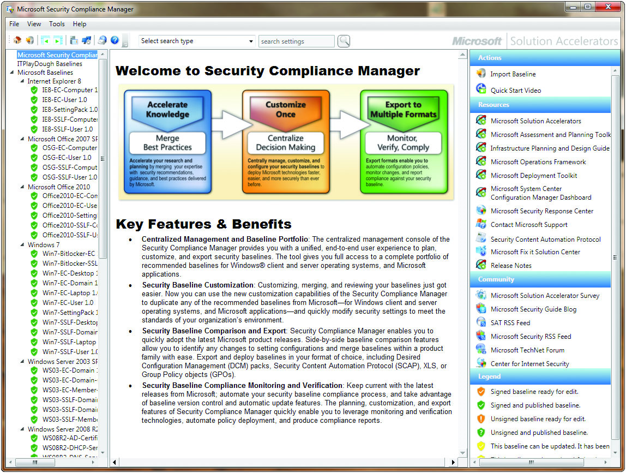
Figure 14.3 Microsoft Security Compliance Manager
Notes:
Figure 14.3 illustrates some of the menu options available in SCM, currently version 3.0.

Slide 23
Microsoft Attack Surface Analyzer
One of the challenges in a modern enterprise is understanding the impact of system changes from the installation or upgrade of an application on a system.
To help you overcome that challenge, Microsoft has released the Attack Surface Analyzer (ASA), a free tool that can be deployed on a system before a change and again after a change to analyze the changes to various system properties as a result of the change.
Notes:
Using ASA, developers can view changes in the attack surface resulting from the introduction of their code onto the Windows platform, and system administrators can assess the aggregate attack surface change by the installation of an application. Security auditors can use the tool to evaluate the risk of a particular piece of software installed on the Windows platform. And if ASA is deployed in a baseline mode before an incident, security incident responders can potentially use ASA to gain a better understanding of the state of a system’s security during an investigation.

Slide 24
Hardening UNIX- or Linux-based Operating Systems
There is no single manufacturer for all UNIX operating systems (like exists with Windows operating systems).
However, the concepts behind securing different UNIX- or Linux-based operating systems are similar whether the manufacturer is Red Hat or Sun Microsystems.
Indeed, the overall tasks involved with hardening all operating systems are remarkably similar.

Slide 25
Establishing General UNIX Baselines
General UNIX baselining follows similar concepts as baselining for Windows OSs:
Disable unnecessary services
Restrict permissions on files and directories
Remove unnecessary software
Apply patches
Remove unnecessary users
Apply password guidelines

Slide 26
Establishing General UNIX Baselines (continued)
Like Windows systems, UNIX systems are easiest to secure and baseline if they are providing a single service or performing a single function.
Unlike Windows, UNIX systems can also have different runlevels.
The system can be configured to bring up different services depending on the runlevel selected.

Slide 27
Establishing General UNIX Baselines (continued)
To stop a running service, an administrator can identify the service by its unique process identifier (PID) and then use the kill command to stop the service.
Most modern UNIX versions store the actual password associated with a user account in a shadow file located in the /etc directory.

Slide 28
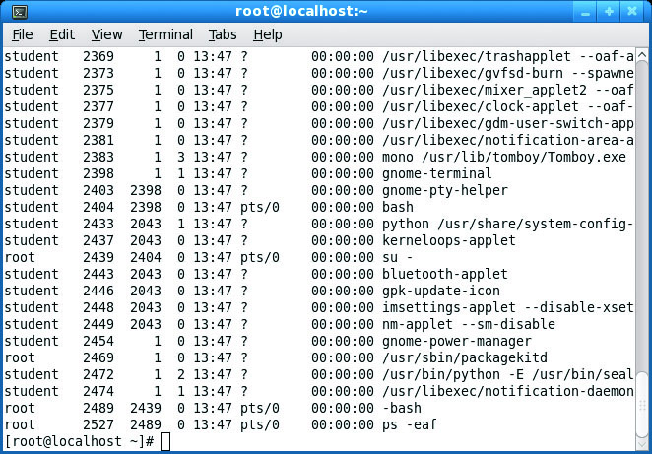
Figure 14.4 ps command run on a Fedora system

Slide 29
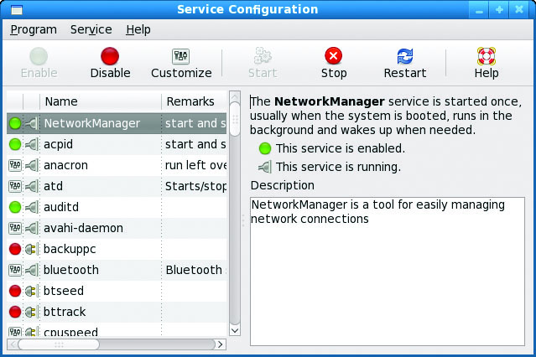
Figure 14.5 Service Configuration utility from a Fedora system

Slide 30
Hardening Linux
Linux is a rather unique operating system.
Services under Linux are normally controlled by their own configuration files or by xinetd, the extended Internet services daemon.
Permissions under Linux are the same as for other UNIX-based operating systems.
Adding and removing software under Linux is typically done through a package manager.
Patching a Fedora Linux system is fairly simple.
Notes:
Managing and maintaining user accounts under Linux can be accomplished with either the command line or a GUI. Unlike certain other operating systems, there’s really only one default account for Linux systems—the root, or superuser, account. The root account has complete and total control over the system and should therefore be protected with an exceptionally strong password. Many administrators will configure their systems to prevent anyone from logging in directly as root; instead they must log in with their own personal accounts and switch to the root account using the su command. Adding user accounts can be done with the useradd command, and
unwanted user accounts can be removed using the userdel command. Additionally you can manually edit /etc/passwd to add or remove user accounts.

Slide 31
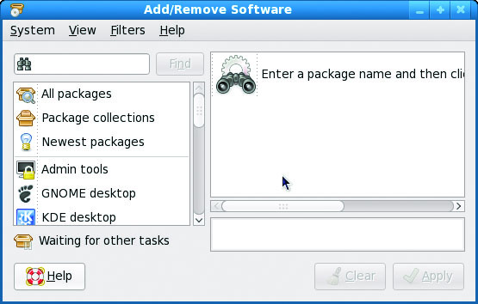
Figure 14.6 Fedora Add/Remove Software utility
Notes:
As with most things under Linux, there is a GUI-based utility to accomplish this same task. The GUI-based Add/Remove Software utility is shown in Figure 14.6.

Slide 32
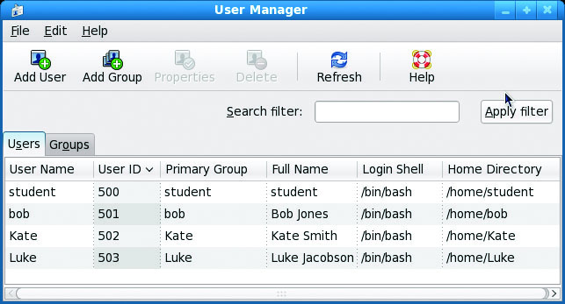
Figure 14.7 Fedora User Manager
Notes:
User accounts can also be managed via a GUI, as shown in Figure 14.7.

Slide 33
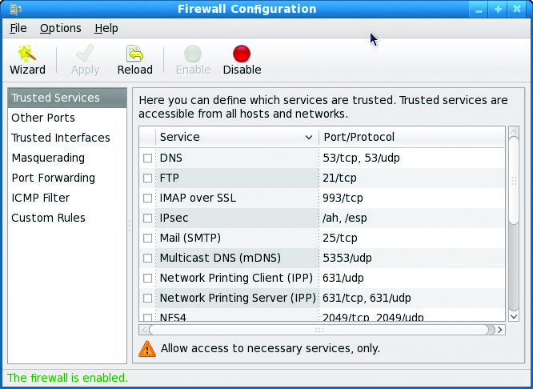
Figure 14.8 Fedora Firewall Configuration GUI
Notes:
For increased local security, Fedora also provides a built-in firewall function that can be managed either via the command line or through a GUI, as shown in Figure 14.8. To protect network access to the local system, administrators can control which ports external users may connect to, such as mail, FTP, or web. Administrators may choose a security level, from high, medium, off, or a customized option that enables them to individually select which ports on which interfaces external users may connect to.

Slide 34
Hardening Mac OS X
Apple’s operating system is essentially a new variant of the UNIX operating system.
While this POSIX-compliant OS brings a new level of power, flexibility, and stability to Mac users everywhere, it also brings a new level of security concerns.
With the migration to a UNIX-based OS and a rise in the number of Macs on the market, Mac users should anticipate a sharp increase in unwanted attention and scrutiny from potential attackers.
Notes:
Because it is a UNIX-based OS, the same rough guidelines for all UNIX systems apply to Mac OS X. Apple has included some security-specific features to help protect its user base:
■ Mandatory access controls for access to system resources – Only processes that are explicitly granted access are allowed to access system resources such as networking, file systems, process execution, and so on.
■ Tagged downloads – Any file downloaded with Safari, iChat, or Mail is automatically tagged with metadata, including the source URL, date and time of download, and so on. If the download was an archive (such as a zip file), the same metadata is tagged to any file extracted from the archive. Users are prompted with this information the first time they try to run or open the downloaded file.
■ Execute disable – Leopard (OS X 10.5) and beyond provides no-execute stack protection. Essentially this means that certain portions of the stack have been marked as “data only” and the OS will not execute any instructions in regions marked as data only. This helps protect against buffer-overflow attacks.
■ Library randomization In another attempt to help defeat buffer overflow attacks, Leopard (OS X 10.5) and beyond loads system libraries into random locations, making it harder for attackers to reference static system library locations in their exploit code.
■ FileVault – FileVault encrypts files with AES encryption. When this feature is enabled, everything in the user’s home directory is automatically encrypted.
■ Application-aware firewall – The Apple Application firewall allows users to restrict network access on both a per-application and a per-port basis.
■ Pre-emptive multitasking and memory protection – These features provide a means for the system to ensure that multiple applications can be run simultaneously without interrupting or corrupting each other.
■ Gatekeeper – The Gatekeeper application is employed to make it safer to download and deploy applications. The combination of the Gatekeeper application and the control Apple exerts over applications in its App store provides one of the safest sets of software distribution.
■ App Sandbox – The App Sandbox in OS X provides a means of ensuring that apps are separated from the OS in ways to protect critical components from malicious software.

Slide 35
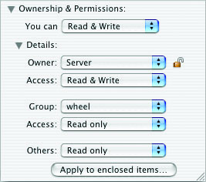
Figure 14.9 Setting file permissions in Mac OS X

Slide 36
Updates (a.k.a. Hotfixes, Service Packs, and Patches)
Vendors typically follow a hierarchy for software updates:
Hotfix refers to a (usually) small software update designed to address a specific problem.
A patch is a more formal, larger software update that may address several or many software problems.
Service pack refers to a large collection of patches and hotfixes rolled into a single, rather large package.

Slide 37
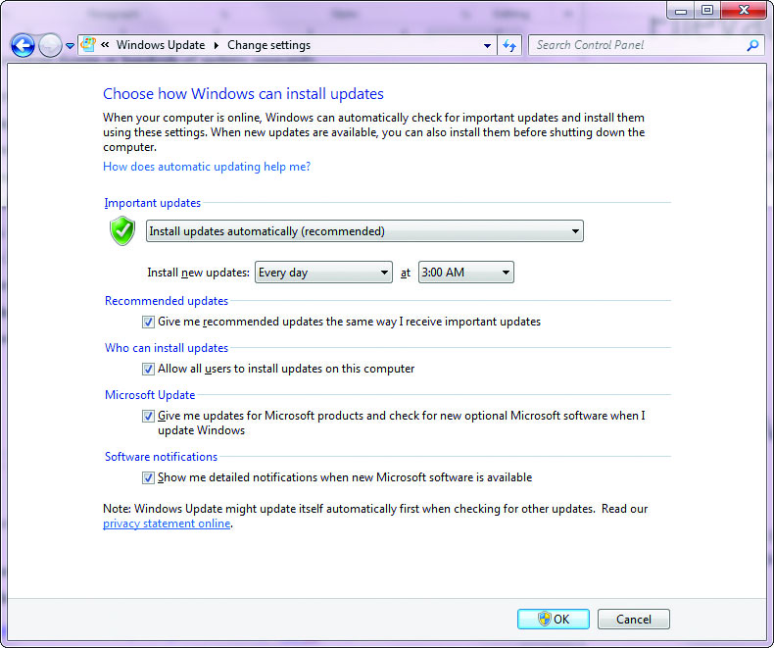
Figure 14.10 Automatic Updates settings in Windows 7
Notes:
Microsoft typically makes updates available for download from its web site. While most administrators or technically proficient users may prefer to identify and download updates individually, Microsoft recognizes that nontechnical users prefer a simpler approach, which Microsoft has built into its operating systems. Beginning with Windows Vista, and Server 2003, Microsoft provides an automated update functionality that will, once configured, locate any required updates, download them to your system, and even install the updates if that is your preference.
Figure 14.10 shows the Automatic Updates window, which can be found in the Control Panel. Note that both the web-based updates and Automatic Updates require active Internet connections to retrieve information and updates from Microsoft.

Slide 38
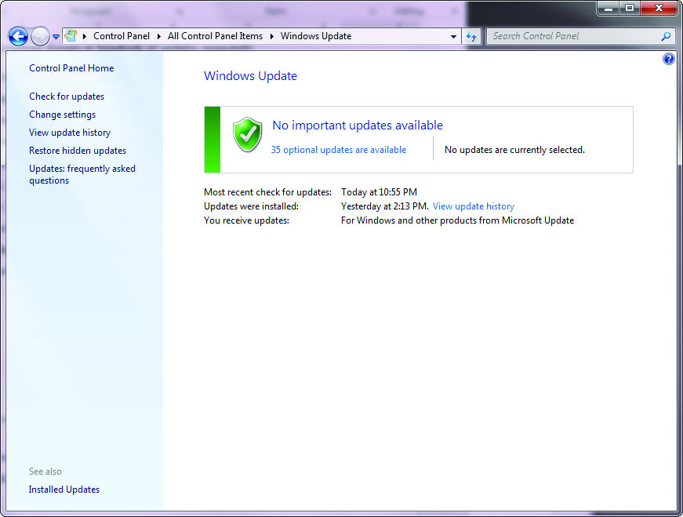
Figure 14.11 Windows Update utility in Windows 7
Notes:
The Windows Update utility (see Figure 14.11) can perform an on-demand search for updates or be configured to scan for, download, and even install updates automatically—essentially the same functions as Automatic Updates with a new look. An especially nice feature of Windows Update is the ability to scan for and download patches for other Microsoft software, such as Office, as well as updates and patches for the operating system itself.

Slide 39
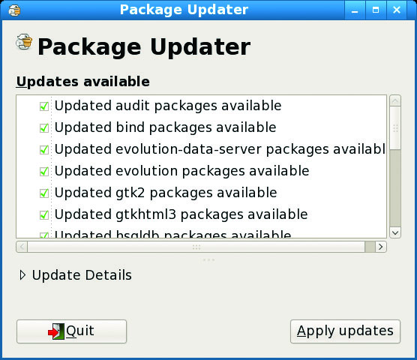
Figure 14.12 Fedora software package update utility
Notes:
Fedora Linux contains a utility called the Package Updater, shown in Figure 14.12, which does essentially the same thing. Running the utility will show you which updates are available and allow you to select which updates to download and apply. As with most operating systems, you can configure Fedora to automatically download and apply available updates.

Slide 40
Operating System Patching
Every OS requires software updates.
Each OS has different methods of assisting users in keeping their systems up to date.
Microsoft typically makes updates available for download from its web site.
How you patch a Linux system depends a great deal on the specific version in use and the patch being applied.
Regardless of the method you use to update the OS, it is critically important to keep systems up to date.

Slide 41
Application Updates
Applications require patches.
Managing the wide variety of applications and the required updates from numerous different software vendors can be a daunting challenge.
There is a niche market for patch-management software.
In most enterprises, some form of automated patch management solution is used; this reduces labor and ensures updates are applied appropriately across the enterprise.

Slide 42
Antimalware
According to SANS Internet Storm Center, the average survival time of an unpatched Windows PC on the Internet is less than 60 minutes.
Automated probes from botnets and worms are not the only threats roaming the Internet.
There are viruses and malware spread by e-mail, phishing, infected web sites that execute code on your system when you visit them, adware, spyware, and so on.
Fortunately, as the threats increase in complexity and capability, so do the products designed to stop them.

Slide 43
Antimalware (continued)
Antivirus (AV) products attempt to identify, neutralize, or remove malicious programs, macros, and files.
Signature-based scanning catches known viruses but is limited by the virus dictionary.
Heuristic scanning typically looks for commands or instructions that are not normally found in application programs, such as attempts to access a reserved memory register.
Most antivirus products use either a weight-based system or a rule-based system in their heuristic scanning.
Notes:
Most antivirus products combine the following approaches when scanning for viruses:
■ Signature-based scanning – Much like an intrusion detection system (IDS), the antivirus products scan programs, files, macros, e-mails, and other data for known worms, viruses, and malware. The antivirus product contains a virus dictionary with thousands of known virus signatures that must be frequently updated, as new viruses are discovered daily. This approach will catch known viruses but is limited by the virus dictionary—what it does not know about it cannot catch.
■ Heuristic scanning (or analysis) – Heuristic scanning does not rely on a virus dictionary. Instead, it looks for suspicious behavior—anything that does not fit into a “normal” pattern of behavior for the OS and applications running on the system being protected.

Slide 44
Antimalware (continued)
The need for antivirus protection on servers depends a great deal on the use of the server.
Some types of servers, such as e-mail servers, require extensive antivirus protection because of the services they provide. Other servers (domain controllers and remote access servers, for example) may not require any antivirus software, as they do not allow users to place files on them.
File servers need protection, as do certain types of application servers.
Notes:
There is no general rule, so each server and its role in the network will need to be examined to determine whether it needs antivirus software.

Slide 45
Antimalware (continued)
Antivirus packages are available from a wide range of vendors.
Running a network of computers without this basic level of protection will be an exercise in futility.
Even though the number of widespread, indiscriminate broadcast virus attacks has decreased because of the effectiveness of antivirus software, it is still necessary to use antivirus software; the time and money you would spend cleaning up after a virus attack more than equals the cost of antivirus protection.
Notes:
The majority of viruses today exist to create zombie machines for botnets that enable others to control resources on your PC. Even more important, once connected by networks, computers can spread a virus from machine to machine with an ease that’s even greater than simple USB flash drive transfer. One unprotected machine can lead to problems throughout a network as other machines have to use their antivirus software to attempt to clean up a spreading infection.

Slide 46
Antimalware (continued)
Antispam products attempt to filter out that endless stream of junk e-mail so you don’t have to.
Some antispam products operate at the corporate level, filtering messages as they enter or leave designated mail servers.
Other products operate at the host level, filtering messages as they come into your personal inbox.
Notes:
Most antispam products use similar techniques and approaches for filtering out spam:
■ Black listing – Several organizations maintain lists of servers or domains that generate or have generated spam. Most gateway- or server-level products can reference these black lists and automatically reject any mail coming from servers or domains on the black lists.
■ Header filtering – The antispam products look at the message headers to see if they are forged. E-mail headers typically contain information such as sender, receiver, servers used to transmit the message, and so on. Spammers often forge information in message headers in an attempt to hide where the message is really coming from.
■Content filtering – The content of the message is examined for certain key words or phrases that are common to spam but rarely seen in legitimate e-mails (“get rich now” for example). Unfortunately, content filtering does occasionally flag legitimate messages as spam.
■ Language filtering – Some spam products allow you to filter out e-mails written in certain languages.
■ User-defined filtering – Most antispam products allow end users to develop their own filters, such as always allowing e-mail from a specific source even if it would normally be blocked by a content filter. ■ Trapping – Some products will monitor unpublished e-mail addresses for incoming spam—anything sent to an unpublished and otherwise unused account is likely to be spam. ■ Enforcing the specifications of the protocol – Some spam generation tools don’t properly follow the SMTP protocol. By enforcing the technical requirements of SMTP, some spam can be rejected as delivery is attempted. ■ Egress filtering – This technique scans mail as it leaves an organization to catch spam before it is sent to other organizations.

Slide 47
Antimalware (continued)
Most antivirus products will include antispyware capabilities as well.
Spyware is the term used to define malware that is designed to steal information from the system, such as keystrokes, passwords, PINs, and keys.
Antispyware helps protect your systems from the ever-increasing flood of malware that seeks to watch your keystrokes, steal your passwords, and report sensitive information back to attackers.

Slide 48
Antimalware (continued)
The stated purpose of Windows Defender is to protect your computer from spyware and other unwanted software.
Windows Defender is standard with all versions of the Vista and Windows 7 operating systems and is available via free download in both 32- and 64-bit versions.
Notes:
It has the following capabilities:
■ Spyware detection and removal – Windows Defender is designed to find and remove spyware and other unwanted programs that display pop-ups, modify browser or Internet settings, or steal personal information from your PC.
■ Scheduled scanning – You can schedule when you want your system to be scanned or you can run scans on demand.
■ Automatic updates – Updates to the product can be automatically downloaded and installed without user interaction. ■ Real-time protection – Processes are monitored in real time to stop spyware and malware when they first launch, attempt to install themselves, or attempt to access your PC. ■ Software Explorer – One of the more interesting capabilities within Windows Defender is the ability to examine the various programs running on your computer. Windows Defender allows you to look at programs that run automatically on startup, are currently running on your PC, or are accessing network connections on your PC. Windows Defender provides you with details such as the publisher of the software, when it was installed on your PC, whether or not the software is “good” or considered to be known malware, the file size, publication date, and other information. ■ Configurable responses – Windows Defender lets you choose what actions you want to take in response to detected threats (see Figure 14.13); you can automatically disable the software, quarantine it, attempt to uninstall it, and perform other tasks.

Slide 49
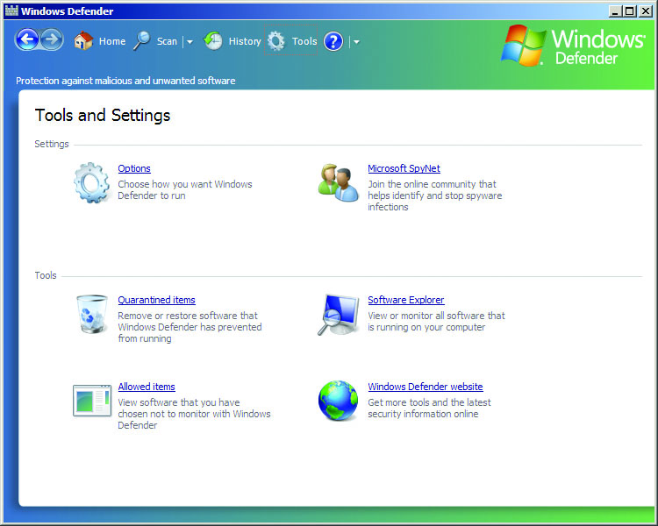
Figure 14.13 Windows Defender configuration options

Slide 50
Antimalware (continued)
Pop-up blockers combat pop-up ads.
Pop-up ads are online advertisements designed to attract web traffic to specific web sites, capture e-mail addresses, advertise a product, and perform other tasks.
To some users, pop-up ads are as undesirable as spam, and many web browsers now allow users to restrict or prevent pop-ups with functionality either built into the web browser or available as an add-on.
Internet Explorer contains a built-in Pop-up Blocker.

Slide 51
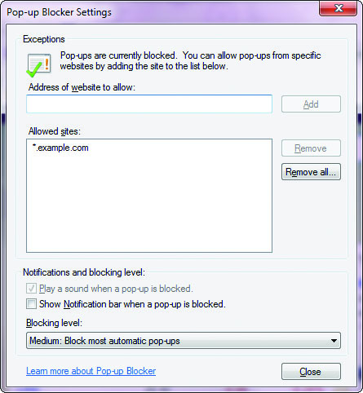
Figure 14.14 Pop-up Blocker in IE 11

Slide 52
White Listing vs. Black Listing Applications
Applications can be controlled at the OS at the time of start via black listing or white listing.
Black listing is essentially noting which applications should not be allowed to run on the machine.
White listing is the exact opposite: it consists of a list of allowed applications.
Microsoft has two mechanisms that are part of the OS to control which users can use which applications:
Software restrictive policies
User account level control
Notes:
Each of these approaches has advantages and disadvantages. Black listing is difficult to use against dynamic threats, as the identification of a specific application can easily be avoided through minor changes. White listing is easier to employ from the aspect of the identification of applications that are allowed to run—hash values can be used to ensure the executables are not corrupted. The challenge in white listing is the number of potential applications that are run on a typical machine. For a single-purpose machine, such as a database server, white listing can be relatively easy to employ. For multipurpose machines, it can be more complicated.
Microsoft has two mechanisms that are part of the OS to control which users can use which applications: ■ Software restrictive policies – Employed via group policies and allow significant control over applications, scripts, and executable files. The primary mode is by machine and not by user account. ■ User account level control – Enforced via AppLocker, a service that allows granular control over which users can execute which programs. Through the use of rules, an enterprise can exert significant control over who can access and use installed software. On a Linux platform, similar capabilities are offered from third-party vendor applications.

Slide 53
White Listing vs. Black Listing Applications (continued)
AppLocker is a component of Windows 7 and later that enables administrators to enforce which applications are allowed to run via a set of predefined rules.
AppLocker is an adjunct to Software Restriction Policies (SRP).
AppLocker and SRP both act to prevent the running of both unauthorized software and malware on a machine, but AppLocker is significantly easier to administer.
Notes:
AppLocker was designed so the rules can be distributed and enforced by GPO.

Slide 54
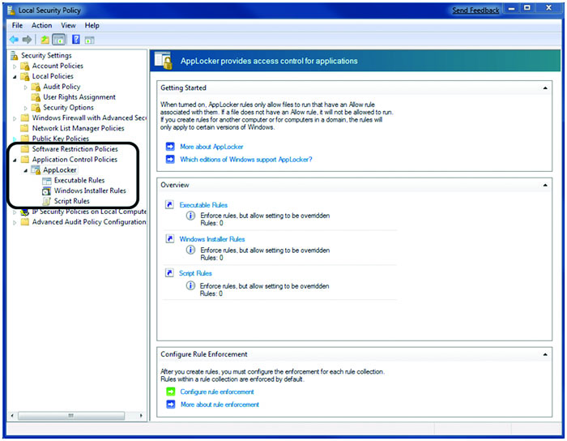
Figure 14.15 AppLocker in Windows 7
Notes:
Figure 14.15 shows the AppLocker interface in Windows 7. Some of the features that are enabled via AppLocker are restrictions by user and the ability to run in an audit mode, where results are logged but not enforced, allowing settings to be tested before use.

Slide 55
Trusted OS
A Trusted Operating System is one that is designed to allow multilevel security in its operation.
This is further defined by its ability to meet a series of criteria required by the U.S. government.
Trusted OSs are expensive to create and maintain because any change must typically undergo a recertification process.
Notes:
The most common criteria used to define a Trusted OS is the Common Criteria for Information Technology Security Evaluation (abbreviated as Common Criteria, or CC), a harmonized security criteria recognized by many nations, including the United States, Canada, Great Britain, and most of the EU countries, as well as others. Versions of Windows, Linux, mainframe OSs, and specialty OSs have been qualified to various Common Criteria levels.

Slide 56
Module 8 System Hardening Baselines Malicious Software and Types of Attacks – Part 2

Slide 57
Host-based Firewalls
Personal firewalls are host-based protective mechanisms that monitor and control traffic passing into and out of a single system.
Designed for the end user, software firewalls often have a configurable security policy that allows the user to determine which traffic is “good” and is allowed to pass and which traffic is “bad” and is blocked.
In addition to the “free” firewalls that come bundled with OSs, many commercial personal firewall packages are available.

Slide 58
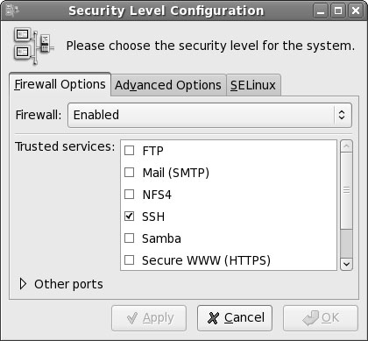
Figure 14.16 Linux firewall
Notes:
Linux-based OSs have had built-in software-based firewalls (see Figure 14.16) for a number of years, including TCP Wrappers, ipchains, and iptables.
TCP Wrappers is a simple program that limits inbound network connections based on port number, domain, or IP address and is managed with two text files called hosts.allow and hosts.deny. If the inbound connection is coming from a trusted IP address and destined for a port to which it is allowed to connect, then the connection is allowed.

Slide 59
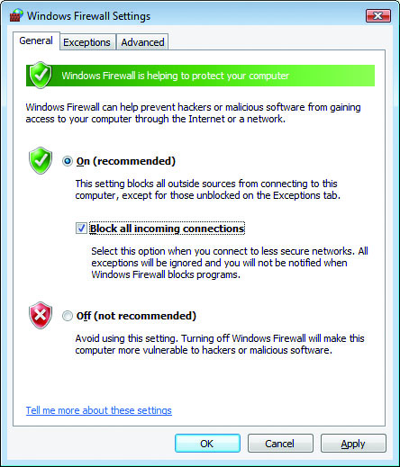
Figure 14.17 Windows Firewall is enabled by default in XP SP2, Vista, and Windows 7.
Notes:
Microsoft Windows has had a personal software firewall since Windows XP SP2. Windows Firewall (see Figure 14.17) is enabled by default and has warnings when disabled. Windows Firewall is fairly configurable; it can be set up to block all traffic, make exceptions for traffic you want to allow, and log rejected traffic for later analysis.
With the introduction of the Vista operating system, Microsoft modified Windows Firewall to make it more capable and configurable. More options were added to allow for more granular control of network traffic as well as the ability to detect when certain components are not behaving as expected. For example, if your MS Outlook client suddenly attempts to connect to a remote web server, Windows Firewall can detect this as a deviation from normal behavior and block the unwanted traffic.

Slide 60
Hardware Security
Hardware, in the form of servers, workstations, and even mobile devices, can represent a weakness or vulnerability in the security system associated with an enterprise.
There are some hardware protection mechanisms that should be employed to safeguard information in servers, workstations, and mobile devices.
Cable locks can prevent their theft.
Locking cabinets and safes can be used to secure portable media, USB drives, and CDs/DVDs.
Notes:
While hardware can be easily replaced if lost or stolen, the information that is contained by the devices complicates the security picture. Data or information can be safeguarded from loss by backups, but this does little in the way of protecting it from disclosure to an unauthorized party. There are software measures that can assist in the form of encryption, but these also have drawbacks in the form of scalability and key distribution.

Slide 61
Host Software Baselining
The process of establishing software’s base security state is called baselining.
The resulting product is a security baseline that allows the software to run safely and securely.
Software and hardware can be tied intimately when it comes to security, so they must be considered together.
Once the process has been completed for a particular hardware and software combination, any similar systems can be configured with the same baseline to achieve the same level and depth of security and protection.
Notes:
Uniform software baselines are critical in large-scale operations, because maintaining separate configurations and security levels for hundreds or thousands of systems is far too costly.

Slide 62
Host-based Security Controls
Security controls can be implemented on a host machine for the express purpose of providing data protection on the host.

Slide 63
Hardware-based Encryption Devices
Hardware-based encryption devices are designed to assist in the encryption/decryption actions via hardware rather than software on a system.
Integration of encryption functionality via hardware offers both performance and security advantages for these solutions.

Slide 64
Hardware-based Encryption Devices (continued)
The Trusted Platform Module (TPM) is a hardware solution on the motherboard that assists with key generation and storage as well as random number generation.
When the encryption keys are stored in the TPM, they are not accessible via normal software channels.
The encryption keys are physically separated from the hard drive or other encrypted data locations.
Notes:
This makes the TPM a more secure solution than storing the keys on the machine’s normal storage.

Slide 65
Hardware-based Encryption Devices (continued)
A hardware security module (HSM) is a device used to manage or store encryption keys.
HSMs are typically peripheral devices, connected via USB or a network connection.
It can also assist in cryptographic operations such as encryption, hashing, or the application of digital signatures.
HSMs have tamper protection mechanisms to prevent physical access to the secrets they protect.
Notes:
Because of their dedicated design, they can offer significant performance advantages over general-purpose computers when it comes to cryptographic operations.

Slide 66
Hardware-based Encryption Devices (continued)
Universal Serial Bus (USB) is a transport mechanism between the computer and an external device.
Data traversing the USB connection typically ends up on a portable device requiring an appropriate level of security.
Many mechanisms exist, from encryption on the USB device itself, to OS-enabled encryption, to independent encryption before moving the data.
Each of these mechanisms has advantages and disadvantages, and it is ultimately up to the user to choose the best method based on the sensitivity of the data.
Notes:
Universal Serial Bus (USB) offers an easy connection mechanism to connect devices to a computer. This acts as the mechanism of transport between the computer and an external device.

Slide 67
Hardware-based Encryption Devices (continued)
Hard drives offering encryption services can provide flexibility in terms of performance and security.
It is possible to buy hard drives today with integrated AES encryption, so that the drive content is secured and the keys can be stored separately in a TPM.
This offers significant performance and security enhancements over other, software-based solutions.

Slide 68
Data Encryption
Data encryption continues to be the best solution for data security.
Properly encrypted, the data is not readable by an unauthorized party.
There are numerous ways to enact this level of protection on a host machine.

Slide 69
Data Encryption (continued)
Full disk encryption refers to the act of encrypting an entire partition in one operation.
Then as specific elements are needed, those particular sectors can be decrypted for use.
This offers a simple convenience factor and ensures that all of the data is protected
It does come at a performance cost, as the act of decrypting and encrypting takes time.
Notes:
For some high-performance data stores, especially those with latency issues, this performance hit may be critical. Although better performance can be achieved with specialized hardware, as with all security controls there needs to be an evaluation of the risk involved versus the costs.

Slide 70
Data Encryption (continued)
Major database engines have built-in encryption capabilities.
The advantage to these encryption schemes is that they can be tailored to the data structure, protecting the essential columns while not impacting columns that are not sensitive.
Properly employing database encryption requires that the data schema and its security requirements be designed into the database implementation.
Notes:
The advantage is in better protection against any database compromise, and the performance hit is typically negligible with respect to other alternatives.

Slide 71
Data Encryption (continued)
Individual files can be encrypted within a system.
File encryption can be done either at the OS level or via a third-party application.
Managing individual file encryption can be tricky, as the problem moves to an encryption key security problem.
When using built-in encryption methods with an OS, the key issue is resolved by the OS itself.
A single key is employed and stored with the user credentials.
Notes:
One of the advantages of individual file encryption comes when transferring data to another user. Transporting a single file via an unprotected channel such as e-mail can be done securely with single-file encryption.

Slide 72
Data Encryption (continued)
Removable media can be moved to another location, making the securing of the data stored on the device essential.
Encryption becomes the tool of choice, and a wide range of encryption methods and applications support the protection of removable media.
Microsoft BitLocker, built in to current editions of its Enterprise, Ultimate, and Pro OSs, offers the ability to protect data stored on removable media.

Slide 73
Data Encryption (continued)
Mobile device security is essential when critical or sensitive data is transmitted to mobile devices.
The protection of mobile devices goes beyond simple encryption of the data.
The device can act as an authorized endpoint for the system, opening up avenues of attack.

Slide 74
Data Security
Data or information is the most important element to protect in the enterprise.
Equipment can be purchased, replaced, and shared without consequence; it is the information that is being processed that has the value.
Data security refers to the actions taken in the enterprise to secure data, wherever it resides: in transit, at rest, or in use.

Slide 75
Data Security (continued)
Data in transit must be protected.
Data has value in the enterprise, but for the enterprise to fully realize the value, data elements need to be shared and moved between systems.
Whenever data is in transit, being moved from one system to another, it needs to be protected.
The most common method of this protection is via encryption.
What is important is to ensure that data is always protected in proportion to the degree of risk associated with a data security failure.

Slide 76
Data Security (continued)
Data at rest must be protected.
Data at rest refers to data being stored.
Data is stored in a variety of formats: in files, in databases, and as structured elements.
Whether in ASCII, XML, JavaScript Object Notation (JSON), or a database, and regardless of on what media it is stored, data at rest still requires protection commensurate with its value.
Again, as with data in transit, encryption is the best means of protection against unauthorized access or alteration.

Slide 77
Data Security (continued)
Data in use must be protected.
Protecting data while in use is a much trickier proposition than protecting it in transit or in storage.
While encryption can be used in these other situations, it is not practical to perform operations on encrypted data.
Protected memory schemes and address space layout randomization are two tools that can be used to prevent data security failures during processing.
Secure coding principles, including the definitive wiping of critical data elements once they are no longer needed, can assist in protecting data in use.
Notes:
Data is processed in applications, is used for various functions, and can be at risk when in system memory or even in the act of processing.

Slide 78
Handling Big Data
Big data is the industry buzzword for very large data sets being used in many enterprises.
Planning for security on this scale requires enterprise-level thinking.
Note that some subset of the information eventually makes its way to a host machine for use.
Notes:
It is at this point that the data is vulnerable, because whatever protection scheme is in place on the large storage system, the data is outside that realm now. This means that local protection mechanisms, such as provided by Kerberos-based authentication, can be critical in managing this type of protection scheme.

Slide 79
Cloud Storage
Cloud computing is the use of online resources for storage, processing, or both.
When storing data in the cloud, encryption can be used to protect the data, so that what is actually stored is encrypted data.
Encryption reduces the risk of data disclosure both in transit to the cloud and back as well as while in storage.

Slide 80
Storage Area Network
A storage area network (SAN) is a means of storing data across a secondary dedicated network.
SANs operate to connect data storage devices as if they were local storage, yet they are separate and can be collections of disks, tapes, and other storage devices.
Because the dedicated network is separate from the normal IP network, accessing the SAN requires going through one of the attached machines.
This makes SANs a bit more secure than other forms of storage, although loss through a compromised client machine is still a risk.

Slide 81
Permissions/ACL
Access control lists (ACLs) form one of the foundational bases for security on a machine.
ACLs can be used by the operating system to make determinations as to whether or not a user can access a resource.
This level of permission restriction offers significant protection of resources and transfers the management of the access control problem to the management of ACLs, a smaller and more manageable problem.

Slide 82
Network Hardening
Proper controls over network access must be established on computers by controlling the services that are running and the ports that are opened for network access.
These network devices should be configured with very strict parameters to maintain network security.
Like normal computer OSs that need to be patched and updated, the software that runs network infrastructure components needs to be updated regularly.
Finally, an outer layer of security should be added by implementing appropriate firewall rules and router ACLs.

Slide 83
Software Updates
Maintaining current vendor patch levels for your software is one of the most important things you can do to maintain security.
This is also true for the infrastructure that runs the network.
Smaller network components do not usually run large software suites and typically have smaller software loaded on internal nonvolatile RAM (NVRAM).
While the update process for this kind of software is typically called a firmware update, this does not change the security implications of keeping it up to date.

Slide 84
Device Configuration
As important as it is to keep software up to date, properly configuring network devices is equally, if not more, important.
Many network devices, such as routers and switches, now have advanced remote management capabilities, with multiple open ports accepting network connections.
Proper configuration is necessary to keep these devices secure.
Notes:
Choosing a good password is very important in maintaining external and internal security, and closing or limiting access to any open ports is also a good step for securing the devices. On the more advanced devices, you must carefully consider what services the device is running, just as with a computer.
Here are some general steps to take when securing networking devices:
■ Limit access to only those who need it – If your networking device allows management via a web interface, SSH, or any other method, limit who can connect to those services. Many networking devices allow you to specify which IP addresses are allowed to connect to those management services.
■ Choose good passwords – Always change default passwords and follow good password selection guidelines. If the device supports encryption, ensure passwords are stored in encrypted format on the device.
■ Password-protect console and remote access – If the device supports password protection, ensure that all local and remote access capabilities are password protected.
■ Turn off unnecessary services – If your networking equipment supports Telnet but your organization doesn’t need it, turn that service off. It’s always a good idea to disable or remove unused services. Your device may also support the use of ACLs to limit access to services such as Telnet or SSH on the device itself.
■ Change SNMP community strings – SNMP is widely used to manage networking equipment and typically allows a “public” string, which can typically only read information from a device, and a “private” string, which can often read and write to a device’s configuration. Some manufacturers use default or well-known strings (such as “public” for the public string)—always change both the public and private strings if you are using SNMP.

Slide 85
Securing Management Interfaces
Some network security devices have “management interfaces” that allow for remote management of the devices themselves.
Often seen on firewalls, routers, and switches, a management interface allows connections to the device’s management application, an SSH service, or even a web-based configuration GUI, which are not allowed on any other interface.
Management interfaces and management applications must be secured against unauthorized access.
Notes:
Due to this high level of access, management interfaces and management applications must be secured against unauthorized access. They should not be connected to public network connections (the Internet) and DMZ connections. Where possible, access to management interfaces and applications should be restricted within an organization so employees without the proper access rights and privileges cannot even connect to those interfaces and applications.

Slide 86
VLAN Management
A virtual LAN, or VLAN, is a group of hosts that communicate as if they were on the same broadcast domain.
A VLAN is a logical construct that can be used to help control broadcast domains, manage traffic flow, and restrict traffic between organizations, divisions.
Layer 2 switches, by definition, will not bridge IP traffic across VLANs, which gives administrators the ability to segment traffic quite effectively.
Notes:
For example, if multiple departments are connected to the same physical switch, VLANs can be used to segment the traffic such that one department does not see the broadcast traffic from the other departments.
By controlling the members of a VLAN, administrators can logically separate network traffic throughout the organization

Slide 87
IPv4 vs. IPv6
IPv4 (Internet Protocol version 4) is the de facto communication standard in use on almost every network around the planet.
Unfortunately, IPv4 contains some inherent shortcomings and vulnerabilities.
In an effort to address these issues, the Internet Engineering Task Force (IETF) launched an effort to update or replace IPv4; the result is IPv6.
Notes:
Using a new packet format and much larger address space, IPv6 is designed to speed up packet processing by routers and supply 3.4×1038 possible addresses (IPv4 uses only 32 bits for addressing; IPv6 uses 128 bits). Additionally, IPv6 has security “built in” with mandatory support for network layer security. Although widely adopted under IPv4, IPsec support is mandatory in IPv6.
The issue now is one of conversion. IPv4 and IPv6 networks cannot talk directly to each other and must rely on some type of gateway. Many operating systems and devices currently support dual IP stacks and can run both IPv4 and IPv6. While adoption of IPv6 is proceeding, it is moving slowly and has yet to gain a significant foothold.

Slide 88
Application Hardening
Perhaps as important as OS and network hardening is application hardening—securing an application against local and Internet-based attacks.
Hardening applications is fairly similar to hardening operating systems—you remove the functions or components you don’t need, restrict access where you can and make sure the application is kept up to date with patches.
In most cases, the last step in that list is the most important for maintaining application security.
Notes:
As most problems with applications tend to be buffer overflows in legitimate user input fields, patching the application is often the only way to secure it from attack.

Slide 89
Application Configuration Baseline
As with operating systems, applications have recommended security and functionality settings.
In some cases, vendors provide those recommend settings, and, in other cases, an outside organization such as NSA, ISSA, or SANS provides recommended configurations for popular applications.
Many large organizations develop their own application configuration baseline—that list of settings, tweaks, and modifications that creates a functional and hopefully secure application for use within the organization.
Notes:
Developing an application baseline and using it anytime that application is deployed within the organization helps to ensure a consistent (and hopefully secure) configuration across the organization.

Slide 90
Application Patches
Application patches most likely come from the vendor that sells the application.
In some cases, such as with Microsoft’s IIS, this is the same company that sold the OS that the application runs on.
In other cases, such as Apache, the vendor is OS independent and provides an application with versions for many different OSs.
Application patches are likely to come in three varieties: hotfixes, patches, and upgrades.
Notes:
Application patches are likely to come in three varieties: hotfixes, patches, and upgrades. As described for OSs earlier in the chapter, hotfixes are usually small sections of code designed to fix a specific problem. For example, a hotfix may address a buffer overflow in the login routine for an application. Patches are usually collections of fixes, tend to be much larger, and are usually released on a periodic basis or whenever enough problems have been addressed to warrant a patch release. Upgrades are another popular method of patching applications, and they tend to be presented with a more positive spin than patches. Even the term upgrade has a positive connotation—you are moving up to a better, more functional, and more secure application. For this reason, many vendors release “upgrades” that consist mainly of fixes rather than new or enhanced functionality.

Slide 91
Patch Management
As the number of patches continues to rise, many organizations struggle to keep up with patches—which patches should be applied immediately, which are compatible with the current configuration, which will not affect current business operations.
To help cope with this flood of patches, many organizations have adopted patch management, the process of planning, testing, and deploying patches in a controlled manner.
Notes:
Patch management is a disciplined approach to the acquisition, testing, and implementation of OS and application patches and requires a fair amount of resources to implement properly. To implement patch management effectively, you must first have a good inventory of the software used in your environment, including all OSs and applications. Then you must set up a process to monitor for updates to those software packages. Many vendors provide the ability to update their products automatically or to automatically check for updates and inform the user when updates are available.
Keeping track of patch availability is merely the first step; in many environments, patches must be analyzed and tested. Does the patch apply to the software you are running? Does the patch address a vulnerability or critical issue that must be addressed immediately? What is the impact of applying that patch or group of patches? Will it break something else if you apply this patch? To address these issues, it is recommended that you use development or test platforms, where you can carefully analyze and test patches before placing them into a production environment. While patches are generally “good,” they are not always exhaustively tested; some have been known to “break” other products or functions within the product being patched; and some have introduced new vulnerabilities while attempting to address an existing vulnerability. The extent of analysis and testing varies widely from organization to organization. Testing and analysis will
also vary depending on the application or OS and the extent of the patch.
Once a patch has been analyzed and tested, administrators have to determine when to apply the patch. As many patches require a restart of applications or services or even a reboot of the entire system, most operational environments apply patches only at specific times, to reduce downtime and possible impact and to ensure administrators are available if something goes wrong. Many organizations will also have a rollback plan that allows them to recover the systems back to a known good configuration prior to the patch, in case the patch has unexpected or undesirable effects. Some organizations require extensive coordination and approval of patches prior to implementation, and some institute “lockout” dates where no patching or system changes (with few exceptions) can be made, to ensure business operations are not disrupted. For example, an e-commerce site might have a lockout between the Thanksgiving and Christmas holidays to ensure the site is always available to holiday shoppers.
With any environment, but especially with larger environments, it can be a challenge to track the update status of every desktop and server in the organization. Documenting and maintaining patch status can be a challenge. However, with a disciplined approach, training, policies, and procedures, even the largest environments can be managed. To assist in their patch-management efforts, many organizations use a patch-management product that automates many of the mundane and manpower-intensive tasks associated with patch management. or example, many patch management products provide the following:
■ Ability to inventory applications and operating systems in use
■ Notification of patches that apply to your environment
■ Periodic or continual scanning of systems to validate patch status and identify missing patches
■ Ability to select which patches to apply and to which systems to apply them
■ Ability to push patches to systems on an on-demand or scheduled basis
■ Ability to report patch success or failure
■ Ability to report patch status on any or all systems in the environment

Slide 92
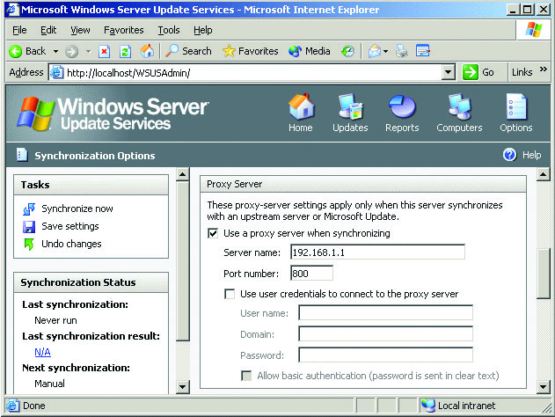
Figure 14.18 Windows Server Update Services
Notes:
Microsoft provides a free patch-management product called Windows Server Update Services (WSUS), shown in Figure 14.18. Using the WSUS product, administrators can manage updates for any compatible Windows-based system in their organization. The WSUS product can be configured to download patches automatically from Microsoft based on a variety of factors (such as OS, product family, criticality, and so on). When updates are downloaded, the administrator can determine whether or not to push out the patches and when to apply them to the systems in their environment. The WSUS product can also help administrators track patch status on their systems, which is a useful and necessary feature.

Slide 93
Host Software Baselining
To secure, configure, and patch software, administrators must first know what software is installed and running on systems.
Maintaining an accurate picture of what operating systems and applications are running inside an organization can be a very labor-intensive task for administrators—especially if individual users have the ability to load software onto their own servers and workstations.
To address this issue, many organizations develop software baselines for hosts and servers.
Notes:
Sometimes called “default,” “gold,” or “standard” configurations, a software baseline contains all the approved software that should appear on a desktop or server within the organization. While software baselines can differ slightly due to disparate needs between groups of users, the more “standard” a software baseline becomes, the easier it will be for administrators to secure, patch, and maintain systems within the organization.

Slide 94
Host Software Baselining (continued)
A vulnerability scanner is a program designed to probe hosts for weaknesses, misconfigurations, old versions of software, and so on.
A network vulnerability scanner probes a host or hosts for issues across their network connections.
Host vulnerability scanners are run on a specific host and look for vulnerabilities and misconfigurations on that host.
Application vulnerability scanners look for vulnerabilities in applications.

Slide 95
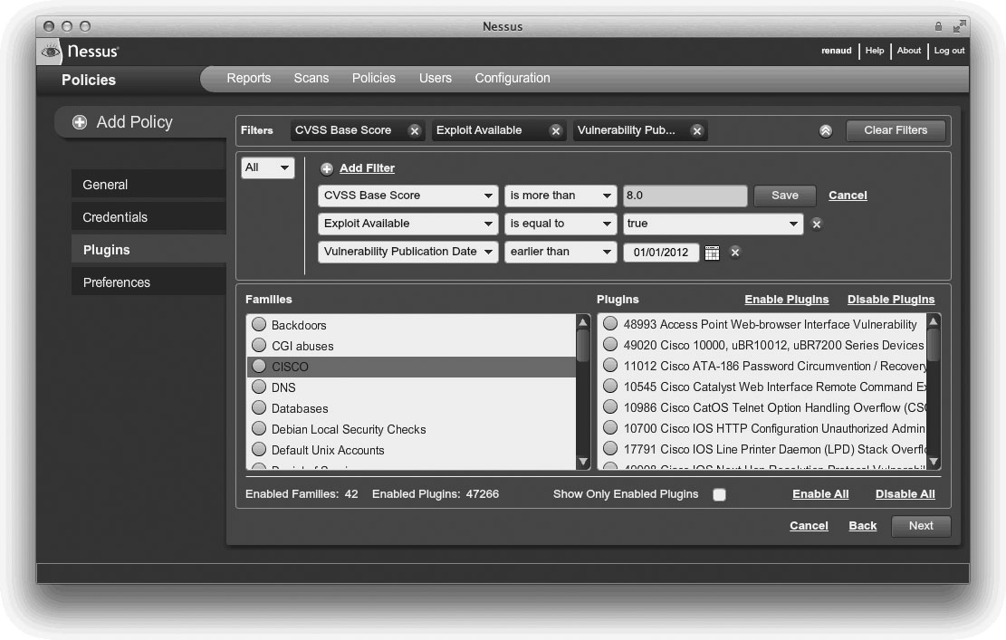
Figure 14.19 Nessus—a network vulnerability scanner
Notes:
Network scanners are essentially the equivalent of a Swiss army knife for assessments. They do lots of tasks and are extremely useful to have around—they may not be as good as a tool dedicated to examining one specific type of service, but if you can only run a single tool to examine your network for vulnerabilities, you’ll want that tool to be a network vulnerability scanner. Figure 14.19 shows a screenshot of Nessus from Tenable Network Security, a very popular network vulnerability scanner.
Bottom line: If you need to perform a broad sweep for vulnerabilities on one or more hosts across the network, a network vulnerability scanner is the right tool for the job.

Slide 96
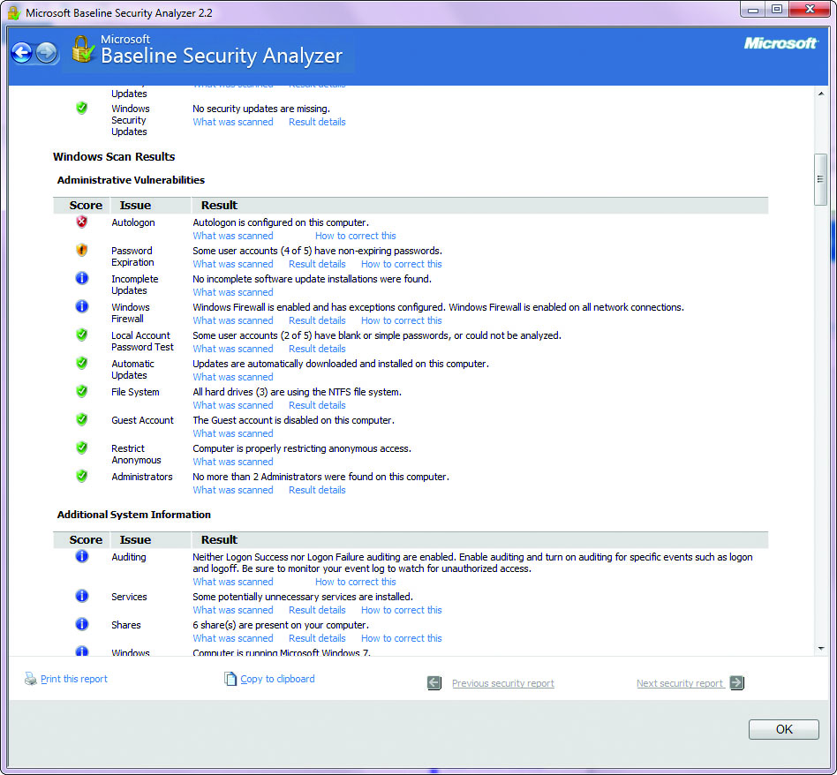
Figure 14.20 Microsoft Baseline Security Analyzer
Notes:
A good example of a host scanner is the Microsoft Baseline Security Analyzer (MBSA), shown in Figure 14.20. MBSA is designed to examine the security state of a Windows host and offer guidance to address any vulnerabilities, misconfigurations, or missing patches. Although MBSA can be run against remote systems across
the network, it is typically run on the host being examined and requires you to have access to that local host (at the Administrator level). The primary thing to remember about host scanners is that they are typically looking for vulnerabilities on the system they are running on.

Slide 97
Group Policies
Microsoft defines a group policy as “an infrastructure used to deliver and apply one or more desired configurations or policy settings to a set of targeted users and computers within an Active Directory environment.
This infrastructure consists of a Group Policy engine and multiple client-side extensions (CSEs) responsible for writing specific policy settings on target client computers.”

Slide 98
Group Policies (continued)
Policy settings are stored in a group policy object (GPO) and are referenced internally by the OS using a globally unique identifier (GUID).
A single policy can be linked to a single user, a group of users, a group of machines, or an entire organizational unit (OU), which makes updating common settings on large groups of users or systems much easier.
Users and systems can have more than one GPO assigned and active, which can create conflicts between policies that must then be resolved at an attribute level.
Group policies can also overwrite local policy settings.
Notes:
Microsoft group policies can provide many useful options including:
■ Network location awareness – Systems are now “aware” of which network they are connected to and can apply different GPOs as needed. For example, a system can have a very restrictive GPO when connected to a public network and a less restrictive GPO when connected to an internal, trusted network.
■ Ability to process without ICMP – Older group policy processes would occasionally time out or fail completely if the targeted system did not respond to ICMP packets. Current implementations in Windows Vista and Windows 7 do not rely on ICMP during the GPO update process.
■ VPN compatibility – As a side benefit of network location awareness, mobile users who connect through VPNs can receive a GPO update in the background after connecting to the corporate network via VPN.
■ Power management – Starting with Windows Vista, power management settings can be configured using GPOs.
■ Device access blocking – Under Windows Vista and Windows 7, policy settings have been added that allow administrators to restrict user access to USB drives, CD-RW drives, DVD-RW drives, and other removable media.
■ Location-based printing – Users can be assigned to various printers based on their location. As mobile users move, their printer locations can be updated to the closest local printer.

Slide 99
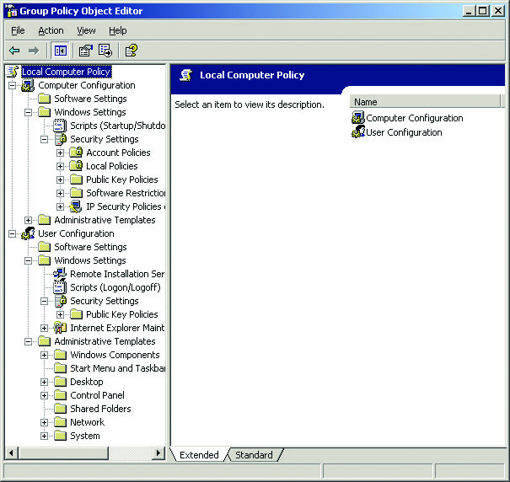
Figure 14.21 Group Policy Object Editor
Notes:
Creating GPOs is usually done through either the Group Policy Object Editor, shown in Figure 14.21, or the Group Policy Management Console (GPMC).

Slide 100
Security Templates
A security template is a collection of security settings that can be applied to a system.
Within the Windows OSs, security templates can contain hundreds of settings that control or modify system settings such as password length, auditing of user actions, or restrictions on network access.
By selecting the settings you want to modify, you can fine-tune the template to create a more (or less) secure system.
Notes:
Security templates can be standalone files that are applied manually to each system, but they can also be part of a group policy, allowing common security settings to be applied to systems on a much wider scale.
Security templates typically configure settings in the following areas:
■ Account policies – Settings for user accounts, such as password length, complexity requirements, account lockouts, and so on.
■ Event log settings – Settings that apply to the three main audit logs within Windows (Application, System, and Security), such as log file size, retention of older entries, and so on.
■ File permissions – Settings that apply to files and folders, such as permission inheritance, locking permissions, and so on.
■ Registry permissions – Settings that control who can access the Registry and how it can be accessed.
■ Restricted groups – Settings that control who should be allowed to join or be part of certain groups. If the user is not already a member of a group as defined in the policy, you will not be able to add that user to the corresponding group on the local system.
■ System services – Settings for services that run on the system, such as startup mode, whether or not users can stop/start the service, and so on.
■ User rights – Settings that control what a user can and cannot do on the system.

Slide 101
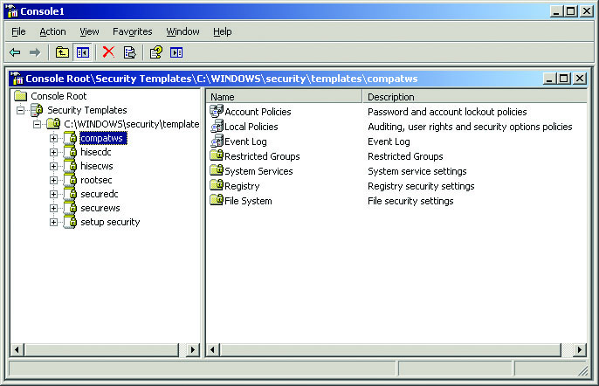
Figure 14.22 MMC with Security Templates snap-in
Notes:
You can create and/or modify security templates on your local system through the Microsoft Management Console (if you have the Security Templates snap-in installed). Microsoft includes a series of predefined security templates (usually stored in \WINDOWS\security\templates) that will appear under Security Templates in your MMC window. These templates range from minimal to maximal security and can all be applied as-is or modified as needed. You can also create a completely new security template and then customize each of the settings to your specifications.
Figure 14.22 shows the MMC with the Security Templates snap-in enabled.

Slide 102
Alternative Environments
Alternative environments are those that are not traditional computer systems in a common IT environment.
These systems are frequently static in nature; that is, their software is unchanging over the course of its function.
Updates and revisions are few and far between.
While this may seem to be counter to current security practices, it is not: because these alternative systems are constrained to a limited, defined set of functionality, the risk from vulnerabilities is limited.
Notes:
Alternative environments are those that are not traditional computer systems in a common IT environment. This is not to say that these environments are rare; in fact, there are millions of systems, composed of hundreds of millions of devices, all across society.
Computers exist in many systems where they perform critical functions specifically tied to a particular system. These alternative systems are frequently static in nature; that is, their software is unchanging over the course of its function. Updates and revisions are few and far between. While this may seem to be counter to current security practices, it isn’t: because these alternative systems are constrained to a limited, defined set of functionality, the risk from vulnerabilities is limited. Examples of these alternative environments include embedded systems, SCADA systems, mobile devices, mainframes, game consoles, and in-vehicle computers.

Slide 103
SCADA
SCADA is an acronym for supervisory control and data acquisition, a system designed to control automated systems in cyber-physical environments.
Modern systems added direct network connections between the SCADA networks and the enterprise IT network.
These connections increase the attack surface and the risk to the system.
The more they resemble an IT networked system, the greater the need for security functions.
Notes:
SCADA systems control manufacturing plants, traffic lights, refineries, energy networks, water plants, building automation and environmental controls, and a host of other systems. SCADA is also known by names such as distributed control systems (DCS) and industrial control systems (ICS), the variations depending on the industry and the configuration. Where computers control a physical process directly, a SCADA system likely is involved.
Most SCADA systems involve multiple components networked together to achieve a set of functional objectives. These systems frequently include a human machine interface (HMI), where an operator can exert a form of directive control over the operation of the system under control. SCADA systems historically have been isolated from other systems, but the isolation is decreasing as these systems are being connected across traditional networks to improve business functionality. Many older SCADA systems were air gapped from the corporate network; that is, they shared no direct network connections. This meant that data flows in and out were handled manually and took time to accomplish. Modern systems wished to remove this constraint and added direct network connections between the SCADA networks and the enterprise IT network. These connections increase the attack surface and the risk to the system, and the more they resemble an IT networked system, the greater the need for security functions.
SCADA systems have been drawn into the security spotlight with the Stuxnet attack on Iranian nuclear facilities, initially reported in 2010. Stuxnet is malware designed to specifically attack a specific SCADA system and cause failures resulting in plant equipment damage. This attack was complex and well designed, crippling nuclear fuel processing in Iran for a significant period of time. This attack raised awareness of the risks associated with SCADA systems, whether connected to the Internet or not (Stuxnet crossed an air gap to hit its target).

Slide 104
Embedded Systems
Embedded system is the name given to a computer that is included as an integral part of a larger system.
The vast majority of security exploits involve getting a device or system to do something it is capable of doing, and technically designed to do, even if the resulting functionality was never an intended use of the device or system.
As capabilities have increased, and these devices have become networked together, the risks have increased significantly.
Notes:
From computer peripherals like printers, to household devices like smart TVs and thermostats, to the car you drive, embedded systems are everywhere. Embedded systems can be as simple as a microcontroller with fully integrated interfaces (a system on a chip) or as complex as the tens of interconnected embedded systems in a modern automobile. Embedded systems are designed with a single control purpose in mind and have virtually no additional functionality, but this does not mean that they are free of risk or security concerns.
The designers of embedded systems typically are focused on minimizing costs, with security seldom seriously considered as part of either the design or the implementation. Because most embedded systems operate as isolated systems, the risks have not been significant. However, as capabilities have increased, and these devices have become networked together, the risks have increased significantly. For example, smart printers have been hacked as a way into enterprises, and as a way to hide from defenders. And when next-generation automobiles begin to talk to each other, passing traffic and other information between them, and begin to have navigation and other inputs being beamed into systems, the risks will increase and security will become an issue. This has already been seen in the airline industry, where the separation of in-flight Wi-Fi, in-flight entertainment, and cockpit digital flight control networks has become a security issue.
Building-automation systems, climate control systems, HVAC systems, elevator control systems, and alarm systems are just some of the examples of systems that are managed by embedded systems. Although these systems used to be independent and standalone systems, the rise of hyperconnectivity has shown value in integrating them. Having a “smart building” that reduces building resources in accordance with the number and distribution of people inside increases efficiency and reduces costs. Interconnecting these systems and adding in Internet-based central control mechanisms does increase the risk profile from outside attacks.

Slide 105
Phones and Mobile Devices
Mobile devices have regular software updates to the OS, and users add applications, making most mobile devices a complete security challenge.
Mobile devices frequently come with Bluetooth connectivity mechanisms.
Protection of the devices from attacks such as bluejacking and bluesnarfing is an important mitigation.
To protect against unauthorized connections, a Bluetooth device should always have discoverable mode turned off unless the user is deliberately pairing the device.
Notes:
Mobile devices may seem to be a static environment, one where the OS rarely changes or is rarely updated, but as these devices become more and more ubiquitous in capability, this is not turning out to be the case.
There are many different operating systems used in mobile devices, the most common of these by market share being Android and iOS from Apple. Android is by far the largest footprint, followed distantly by Apple’s iOS. Microsoft and Blackberry have their own OSs, but neither has major numbers of users.

Slide 106
Phones and Mobile Devices (continued)
Android is a generic name associated with the mobile OS that is based on Linux.
Android has had numerous security issues over the years, ranging from vulnerabilities that allow attackers access to the OS, to malware-infected applications.
The issue of malware-infected applications is much tougher to resolve, as the ability to create content and add it to the app store (Google Play) is considerably less regulated than in the Apple and Microsoft ecosystems.
Notes:
Google acquired the Android platform, made it open source, and began shipping devices in 2008. Android has undergone several updates since, and most systems have some degree of customization added for specific mobile carriers. The Android platform continues to evolve as the code is cleaned up and the number of vulnerabilities is reduced.
The use of mobile device management (MDM) systems is advised in enterprise deployments, especially when BYOD occurs. This and other security aspects specific to mobile devices are covered in Chapter 12.

Slide 107
Phones and Mobile Devices (continued)
iOS is the name of Apple’s proprietary operating system for its mobile platforms.
Because Apple does not license the software for use other than on its own devices, Apple retains full and complete control over the OS and any specific capabilities.
Apple has also exerted significant control over its application store, which has dramatically limited the incidence of malware in the Apple ecosystem.

Slide 108
Phones and Mobile Devices (continued)
A common hack associated with iOS devices is the jailbreak.
Jailbreaking is a process by which the user escalates their privilege level, bypassing the operating system’s controls and limitations.
There are several schools of thought concerning the utility of jailbreaking, but the important issue from a security point of view is that running any device with enhanced privileges can result in errors that cause more damage, because normal security controls are typically bypassed.
Notes:
The user still has the complete functionality of the device, but also has additional capabilities, bypassing the OS-imposed user restrictions.

Slide 109
Mainframe
The security associated with mainframe systems tends to be built into the operating system on specific-purpose mainframes.
Mainframes have become a cost-effective solution for many high-volume applications because many instances of virtual machines can run on the mainframe hardware.
This opens the door for many new security vulnerabilities—not on the mainframe hardware per se, but rather through vulnerabilities in the guest OS in the virtual environment.
Notes:
Mainframes represent the history of computing, and although many people think they have disappeared, they are still very much alive in enterprise computing. Mainframes are high-performance machines that offer large quantities of memory, computing power, and storage. Mainframes have been used for decades for high-volume transaction systems as well as high performance computing.
Mainframe environments tend to have very strong configuration control mechanisms, and very high levels of stability.

Slide 110
Game Consoles
Computer-based game consoles can be considered a type of embedded system designed for entertainment.
With the rise of multifunction entertainment consoles, the attack surface of a gaming console can be fairly large, but it is still constrained by the closed nature of the gaming ecosystem.
As game consoles become more general in purpose and include features such as web browsing, the risks increase to levels commensurate with any other general computing platform.
Notes:
The OS in a game console is not there for the user, but rather there to support the specific applications or game. There typically is no user interface to the OS on a game console for a user to interact with; rather, the OS is designed for a sole purpose. Updates for the firmware and OS-level software are provided by the console manufacturer. This closed environment offers a reasonable level of risk associated with the security of the systems that are connected.

Slide 111
In-vehicle Computing Systems
Motor vehicles have had embedded computers in them for years, regulating engine functions, environmental controls, and dashboard displays.
As the in-vehicle computing systems continue to integrate with mobile electronics, and with the coming vehicle-to-vehicle and vehicle-to-roadway communications, security risks will increase and become a pressing issue.
Notes:
Recently the functionality has expanded to onscreen entertainment and navigation systems. As the functionality of the systems is expanding, with the addition of networking capability, the same security risks associated with other networked systems emerge.

Slide 112
Alternative Environment Methods
Many of the alternative environments can be considered static systems.
Static systems are those that have a defined scope and purpose and do not regularly change in a dynamic manner.
Static systems tend to have closed ecosystems, with complete control over all functionality by a single vendor.
A wide range of security techniques can be employed in the management of alternative systems.
Notes:
Network segmentation, security layers, wrappers, and firewalls assist in the securing of the network connections between these systems. Manual updates, firmware control, and control redundancy assist in the security of the device operation.

Slide 113
Network Segmentation
Network segmentation is the use of the network architecture to limit communication between devices.
A variety of networking mechanisms can be used to limit access to devices at the network level.
Logical network segmentation can be done via VLANs, MAC and IP address restrictions at routers and switches, firewall filtering, and access control mechanisms.
Notes:
One of the challenges with alternative systems is that the devices themselves may not have typical security controls such as access controls or encryption included in their function sets. This makes external controls such as network segmentation even more critical as part of a security solution.

Slide 114
Security Layers
The use of different layers to perform different functions has been a staple of computer science for decades.
Employing layers to enforce security aspects has also been a long-standing concept.
Not all layers have the same information or processing capability.
Using each layer to achieve a part of the security solution leads to more robust security solutions.
Notes:
While a network can manage traffic based on networking information, this is not a complete security solution.
Adding additional layers, such as application layer firewalls and authentication services, adds additional security functions that further reduce the risk associated with the system.

Slide 115
Application Firewalls
Application firewalls are policy-enforcement mechanisms that operate at the application layer to enforce a set of communication rules.
While a network firewall examines network traffic and enforces rules based on addresses, an application firewall adds significantly greater ability to control an application’s communications across the network.

Slide 116
Manual Updates
Manual updates can be used to restrict the access to the system, preventing unauthorized changes to a system.
In some cases, because of scale, an automated system may be used to push out the updates.
The principle of tightly controlling access to system update functionality needs to be preserved.
Notes:
All systems eventually require updates to fix issues, patch vulnerabilities, and even change functionality. In alternative environments, these changes are in many cases done in a manual manner.

Slide 117
Firmware Version Control
Maintaining strict control measures over the changing of firmware is essential to ensuring the authenticity of the software on a system.
Firmware updates require extreme quality measures to ensure that errors are not introduced as part of an update process.
Updating firmware, although only occasionally necessary, is a very sensitive event, for failure can lead to system malfunction.
Notes:
Firmware is present in virtually every system, but in many embedded systems it plays an even more critical role, as it may also contain the OS and application.
If an unauthorized party is able to change the firmware of a system, as demonstrated in an attack against ATMs, an adversary can gain complete functional control over a system

Slide 118
Wrappers
TCP wrappers are structures used to enclose or contain some other system.
Wrappers have been used in a variety of ways, including to obscure or hide functionality.
A Trojan horse is a form of wrapper.
Wrappers also can be used to encapsulate information, such as in tunneling or VPN solutions.
Wrappers can act as a form of channel control, including integrity and authentication information that a normal signal cannot carry.
Notes:
It is common to see wrappers used in alternative environments to prepare communications for IP transmission.

Slide 119
Control Redundancy and Diversity
Many alternative environments are not equipped with on-board encryption, access control, or authentication services.
Designing overlapping controls such that each assists the others but does not duplicate them adds significant strength to a security solution.
A diversity of controls in redundant, overlapping structures is the best method of providing this level of mitigation.
Notes:
The objective is to raise barriers to entry, preventing unauthorized parties from reaching vulnerabilities, and to mitigate those vulnerabilities they can reach such that the attacker cannot proceed further. There is no such thing as perfect security, but a series of overlapping controls can make exploitation nearly impossible.
When the system is in an alternative environment, whether static or not, the principles of security still apply. In fact, in many cases, they are even more critical because the devices themselves have little to no security functionality and thus depend on the supporting environment to be secure.

Slide 120
Chapter Summary
Harden operating systems and network operating systems.
Implement host-level security.
Harden applications.
Establish group policies.
Secure alternative environments (SCADA, real-time, etc.).

Slide 121
Module 8 System Hardening Baselining, Types of Attacks and Malicious Software Part 3

Slide 122
Key Terms
Auditing
Backdoor
Birthday attack
Botnet
Buffer overflow
Denial-of-service (DoS) attack
Distributed denial-of-service (DDoS) attack
DNS kiting
Drive-by download attack
Integer overflow
Logic bomb
Notes:
Auditing – Actions or processes used to verify the assigned privileges and rights of a user, or any capabilities used to create and maintain a record showing who accessed a particular system and what actions they performed.
Backdoor – A hidden method used to gain access to a computer system, network, or application. Often used by software developers to ensure unrestricted access to the systems they create. Synonymous with trapdoor.
Birthday attack – A form of attack in which the attack needs to match not a specific item but just one of a set of items.
Botnet – A term for a collection of software robots, or bots, that runs autonomously and automatically and commonly invisibly in the background. The term is most often associated with malicious software, but it can also refer to the network of computers using distributed computing software.
Buffer overflow – A specific type of software coding error that enables user input to overflow the allocated storage area and corrupt a running program.
Denial-of-service (DoS) attack – An attack in which actions are taken to deprive authorized individuals from accessing a system, its resources, the data it stores or processes, or the network to which it is connected.
Distributed denial-of-service (DDoS) attack – A special type of DoS attack in which the attacker elicits the generally unwilling support of other systems to launch a many-against-one attack.
DNS kiting – The use of a DNS record during the payment grace period without paying.
Drive-by download attack – An attack on an innocent victim machine where content is downloaded without the user’s knowledge.
Integer overflow – An error condition caused by the mismatch between a variable assigned storage size and the size of the value being manipulated.
Logic bomb – A form of malicious code or software that is triggered by a specific event or condition. See also time bomb.

Slide 123
Key Terms (continued)
Malware
Man-in-the-middle attack
Null session
Pharming
Phishing
Ransomware
Replay attack
Rootkit
Sequence number
Smurf attack
Sniffing
Spear phishing
Spoofing
Spyware
Notes:
Malware – A class of software that is designed to cause harm.
Man-in-the-middle attack – Any attack that attempts to use a network node as the intermediary between two other nodes. Each of the endpoint nodes thinks it is talking directly to the other, but each is actually talking to the intermediary.
Null session – The way in which Microsoft Windows represents an unauthenticated connection.
Pharming – The use of a fake web site to socially engineer someone out of credentials.
Phishing – The use of social engineering to trick a user into responding to something such as an e-mail to instantiate a malware-based attack.
Ransomware – Malware that encrypts sensitive files and offers their return for a ransom.
Replay attack – An attack where data is replayed through a system to reproduce a series of transactions.
Rootkit – A form of malware that modifies the OS in a system to change the behavior of the system.
Sequence number – A number within a TCP packet to maintain TCP connections and conversation integrity.
Smurf attack – A method of generating significant numbers of packets for a DoS attack.
Sniffing – The use of a software or hardware device (sniffer) to observe network traffic as it passes through a network on a shared broadcast media.
Spear phishing – A form of targeted phishing where specific information is included to convince the recipient that the communication is genuine.
Spoofing – Making data appear to have originated from another source so as to hide the true origin from the recipient.
Spyware – Malware designed to spy on a use, typically recording information such as keystrokes for passwords.

Slide 124
Key Terms (continued)
SYN flood
TCP/IP hijacking
Trojan
Typo squatting
Virus
Worm
Zombie
Notes:
SYN flood – A method of performing DoS by exhausting TCP connection resources through partially opening connections and letting them time-out.
TCP/IP hijacking – An attack where the attacker intercepts and hijacks an established TCP connection.
Trojan – A form of malicious code that appears to provide one service (and may indeed provide that service) but that also hides another purpose. This hidden purpose often has a malicious intent. This code may also be referred to as a Trojan horse.
Typo squatting – An attack form that involves capitalizing upon common typo errors.
Virus – A form of malicious code or software that attaches itself to other pieces of code in order to replicate. Viruses may contain a payload, which is a portion of the code that is designed to execute when a certain condition is met (such as on a certain date). This payload is often malicious in nature.
Worm – An independent piece of malicious code or software that self-replicates. Unlike a virus, it does not need to be attached to another piece of code. A worm replicates by breaking into another system and making a copy of itself on this new system. A worm can contain a destructive payload but does not have to.
Zombie – A machine that is at least partially under the control of a botnet.

Slide 125
Avenues of Attack
A computer system is attacked for one of two general reasons:
It is specifically targeted by an attacker.
Political reason
Chosen based on attacker’s motivation
Not reliant on target system’s hardware and software
It is a target of opportunity.
Systems with hardware or software vulnerable to a specific exploit
Difficult and take time and effort
Notes:
Generally, computer systems are attacked either as specific targets or merely as targets of opportunity.
An attacker’s motivation in specifically targeting a system may be political, monetary, or other.
In these instances the choice to attack does not rely on the exact hardware and software being used in the targeted system, but rather proceeds in spite of these details.
Target of opportunity attacks succeed when systems are found which have not been updated with the most current security patches and are therefore vulnerable to specific exploits.

Slide 126
Minimizing Possible Avenues of Attack
Steps to minimize possible attacks include:
Ensure all patches for the operating system and applications are installed.
Limit the services that are running on the system.
Limit public disclosure of private information about your organization and its computing resources.

Slide 127
Malicious Code
Malicious code, or malware, refers to software that has been designed for some nefarious purpose.
Patching of vulnerabilities is important, for it closes the point of entry for most malware.
Types of malicious software include:
Viruses, Trojan horses, logic bombs, spyware, and worms
Malware can be fairly complex in its construction.
Multipartite, polymorphic, and metamorphic
Notes:
Malware can be fairly complex in its construction, with specific features designed to assist malware in avoiding detection. Modern malware can be multipart in construction, where several pieces work together to achieve a desired effect.
When malware has multiple different objects that it specifically attacks, it is called multipartite.
Many types of malware can include a changing encryption layer to resist pattern-matching detection. These are called polymorphic.
If the malware actually changes the code at time of infection, this property is called metamorphic.

Slide 128
Viruses
The best-known type of malicious code is the virus.
A virus is a piece of malicious code that replicates by attaching itself to another piece of executable code.
When the other executable code is run, the virus also executes and has the opportunity to infect other files and perform any other nefarious actions it was designed to do.
The specific way that a virus infects other files, and the type of files it infects, depends on the type of virus.
The first viruses created were of two types:
Boot sector viruses and program viruses

Slide 129
Viruses (continued)
A boot sector virus infects the boot sector portion of a floppy disk or hard drive.
A program virus attaches itself to executable files so that it is executed before the program executes.
Most program viruses also hide a nefarious purpose, such as deleting the hard drive data.
A macro virus results from software that includes macro-programming languages.
Best practice is to advise users never to open a document attached to an e-mail if it seems at all suspicious.
Notes:
Boot Sector Virus – A boot sector virus infects the boot sector portion of either a floppy disk or a hard drive (years ago, not all computers had hard drives, and many booted from a floppy). When a computer is first turned on, a small portion of the operating system is initially loaded from hardware. This small operating system then attempts to load the rest of the operating system from a specific location (sector) on either the floppy or the hard drive. A boot sector virus infects this portion of the drive.
Program Virus – A program virus attaches itself to executable files—typically files ending in .exe or .com on Windows-based systems. The virus is attached in such a way that it is executed before the program executes. Most program viruses also hide a nefarious purpose, such as deleting the hard drive data, which is triggered by a specific event, such as a date or after a certain number of other files are infected. Like other types of viruses, program viruses are often not detected until after they execute their malicious payload. One method that has been used to detect this sort of virus before it has an opportunity to damage a system is to calculate checksums for commonly used programs or utilities. Should the checksum for an executable ever change, it is quite likely that it is due to a virus infection.
Macro Virus – In the late 1990s, another type of virus appeared that now accounts for the majority of viruses. As systems and operating systems became more powerful, the boot sector virus, which once accounted for most reported infections, became less common. Systems no longer commonly booted from floppies, which were the main method for boot sector viruses to spread. Instead, the proliferation of software that included macro-programming languages resulted in a new breed of virus—the macro virus.
This type of virus is so common today that it is considered a security best practice to advise users never to open a document attached to an e-mail if it seems at all suspicious. Many organizations now routinely have their mail servers eliminate any attachments containing Visual Basic macros.

Slide 130
Viruses (continued)
To avoid virus infection:
Be cautious about executing programs or opening documents sent to you.
Install and run an antivirus program and maintain an up-to-date listing of virus signatures for the software.
Stay on top of the latest updates for known viruses.
Two advances in virus writing have made it more difficult for antivirus software to detect viruses.
Stealth virus
Polymorphic virus
Notes:
Two advances in virus writing have made it more difficult for antivirus software to detect viruses. These advances are the introduction of stealth virus techniques and polymorphic viruses.
A stealthy virus employs techniques to help evade being detected by antivirus software that uses checksums or other techniques.
Polymorphic viruses also attempt to evade detection, but they do so by changing the virus itself (the virus “evolves”). Because the virus changes, signatures for that virus may no longer be valid, and the virus may escape detection by antivirus software.

Slide 131
Viruses (continued)
Armored viruses resist being reverse-engineered.
Makes the process of determining information from reverse engineering a viruses functionality more difficult.
Users are susceptible to virus hoaxes due to prior virus outbreaks.
Word is spread about a new virus and the danger it poses.
A hoax may warn users to not read certain files or connect to the Internet.
Hoaxes can actually be even more destructive than just wasting time and bandwidth.
Notes:
When a new form of malware/virus is discovered, antivirus companies and security researchers will decompile the program in an attempt to reverse engineer its functionality. Much can be determined from reverse engineering, such as where the malware came from, how it works, how it communicates, how it spreads, and so forth. Armoring malware can make the process of determining this information much more difficult, if not impossible. Some malware, such as Zeus, comes encrypted in ways to prevent criminals from stealing the intellectual property of the very malware that they use.
Viruses have caused so much damage to systems that many Internet users become extremely cautious anytime they hear a rumor of a new virus. Many users will not connect to the Internet when they hear about a virus outbreak, just to be sure their machines don’t get infected. This has given rise to virus hoaxes, in which word is spread about a new virus and the extreme danger it poses. It may warn users to not read certain files or connect to the Internet.
Hoaxes can actually be even more destructive than just wasting time and bandwidth. Some hoaxes warning of a dangerous virus have included instructions to delete certain files if they’re found on the user’s system. Unfortunately for those who follow the advice, the files may actually be part of the operating system, and deleting them could keep the system from booting properly. This suggests another good piece of security advice: make sure of the authenticity and accuracy of any virus report before following somebody’s advice. Antivirus software vendors are a good source of factual data for this sort of threat as well.

Slide 132
Worms
Worms are pieces of code that attempt to penetrate networks and computer systems.
Once a penetration occurs, the worm will create a new copy of itself on the penetrated system.
Reproduction of a worm thus does not rely on the attachment of the virus to another piece of code or to a file, which is the definition of a virus.
There is an important distinction:
Virus code has to attach itself to something else.
Worm code can “survive” on its own.
Notes:
It was once easy to distinguish between a worm and a virus. Recently, with the introduction of new breeds of sophisticated malicious code, the distinction has blurred.
Viruses were generally thought of as a system-based problem, and worms were network-based. If the malicious code is sent throughout a network, it may subsequently be called a worm.

Slide 133
Worms (continued)
Protection against worms depends on the type of worm.
Avoid worms attached and propagated by e-mail.
Do not open files or run attachments unless you are absolutely sure of their origin and integrity.
Secure systems and networks against penetration.
Install patches, eliminate unused and unnecessary services, enforce good password security, and use firewalls and intrusion detection systems.
Sophisticated attacks are almost impossible to avoid.
Notes:
How you protect your system against worms depends on the type of worm.
Those attached and propagated through e-mail can be avoided by following the same guidelines about not opening files and not running attachments unless you are absolutely sure of their origin and integrity.
Protecting against worms involves securing systems and networks against penetration in the same way you would protect your systems against human attackers: install patches, eliminate unused and unnecessary services, enforce good password security, and use firewalls and intrusion detection systems.
More sophisticated attacks, such as the Samy worm, are almost impossible to avoid.

Slide 134
Polymorphic Malware
One of the primary means of avoiding detection by sensors is the use of polymorphic code.
This is code that changes on a regular basis.
These changes or mutations are designed not to affect the functionality of the code, but rather to mask any signature from detection.
Polymorphic programs can change their coding after each use, making each replicant different from a detection point of view.
Notes:
The detection of malware by antimalware programs is primarily done through the use of a signature. Files are scanned for sections of code in the executable that act as markers, unique patterns of code that enable detection. Just as the human body creates antigens that match marker proteins, antimalware programs detect malware through unique markers present in the code of the malware. Malware writers are aware of this functionality and have adapted methods to defeat it.

Slide 135
Trojan Horses
A Trojan horse, or simply Trojan, is a piece of software that appears to do one thing (and may, in fact, actually do that thing) but hides some other functionality.
A Trojan is a standalone program that must be copied and installed by the user.
To prevent the introduction of a Trojan:
Never to run software if you are unsure of its origin, security, and integrity
Keep a virus-checking program running on the system
Notes:
A Trojan horse is software that appears to do one thing but includes some hidden functionality.
Unlike a virus, which reproduces by attaching itself to other files or programs, a Trojan is a standalone program that must be copied and installed by the user—it must be “brought inside” the system by an authorized user.
The challenge for the attacker is enticing the user to copy and run the program. This generally means that the program must be disguised as something that the user would want to run—a special utility or game, for example.
Once it has been copied and is inside the system, the Trojan will perform its hidden purpose, with the user often still unaware of its true nature.
Prevention:
The single best method to prevent the introduction of a Trojan to your system is never to run software if you are unsure of its origin, security, and integrity.
A virus-checking program may also be useful in detecting and preventing the installation of known Trojans. Another way to prevent a Trojan Horse is to keep a virus-checking program running on the system.

Slide 136
Rootkits
A rootkit is a form of malware specifically designed to modify the operation of the operating system in some fashion to facilitate nonstandard functionality.
Can do virtually anything that the operating system does
Designed to avoid the security functions of the operating system to avoid detection using subversion or evasion
Can load before the operating system loads, acting as a virtualization layer
Acts as a form of malware and can exist in firmware and as loadable library modules
Notes:
A rootkit is a form of malware that is specifically designed to modify the operation of the operating system in some fashion to facilitate nonstandard functionality.
Rootkits were originally designed to allow a program to take greater control over operating system function when it fails or becomes unresponsive.
They can do virtually anything that the operating system does.
Rootkits modify the operating system kernel and supporting functions, changing the nature of the system’s
operation.
Rootkits are designed to avoid, either by subversion or evasion, the security functions of the operating system to avoid detection.
Rootkits act as a form of malware that can change thread priorities to boost an application’s performance, perform keylogging, act as a sniffer, hide other files from other applications, or create backdoors in the authentication system.
The use of rootkit functionality to hide other processes and files enables an attacker to use a portion of a computer without the user or other applications knowing what is happening. This hides exploit code from antivirus and antispyware programs, acting as a cloak of invisibility.
Rootkits can load before the operating system loads, acting as a virtualization layer, as in SubVirt and Blue Pill.
Rootkits can exist in firmware and these have been demonstrated in both video cards and PCI expansion cards.
Rootkits can exist as loadable library modules, effectively changing portions of the operating system outside the kernel.
Once a rootkit is detected, it needs to be removed and cleaned up. Because of rootkits’ invasive nature, and the fact that many aspects of rootkits are not easily detectable, most system administrators don’t even attempt to clean up or remove a rootkit. It is far easier to use a previously captured clean system image and reimage the machine than to attempt to determine the depth and breadth of the damage and fix individual files..
There are five main types of rootkits as listed below: • Firmware – Attacks firmware on a system • Virtual – Attacks at the virtual machine level • Kernel – Attacks the kernel of the OS • Library – Attacks libraries used on a system • Application level – Attacks specific applications

Slide 137
Logic Bombs
Logic bombs are a type of malicious software that is deliberately installed, generally by an authorized user.
A logic bomb is a piece of code that sits dormant for a period of time until some event invokes its malicious payload.
Logic bombs are difficult to detect.
They demonstrate the need for a separation of duties and a periodic review of all programs and services that are running on a system.
They reinforce need for active backups.
Notes:
Logic bombs are difficult to detect because they are often installed by authorized users and, in particular, by administrators who are also often responsible for security. This demonstrates the need for a separation of duties and a periodic review of all programs and services that are running on a system. It also illustrates the need to maintain an active backup program so that if your organization loses critical files to this sort of malicious code, it loses only transactions that occurred since the most recent backup and no permanent loss of data results.

Slide 138
Spyware
Spyware is software that “spies” on users, recording and reporting on their activities.
Typically installed without user knowledge, spyware can do a wide range of activities.
It can record keystrokes (commonly called keylogging) when the user logs into specific web sites.
It can monitor how a user uses a specific piece of software (monitor attempts to cheat at games).
Many states have passed legislation banning the unapproved installation of software.
Notes:
Many uses of spyware seem innocuous at first, but the unauthorized monitoring of a system can be abused very easily. In other cases, the spyware is specifically designed to steal information. Many states have passed legislation banning the unapproved installation of software, but many cases of spyware circumvent this issue through complex and confusing end-user license agreements.

Slide 139
Adware
Software that is supported by advertising is called adware.
Adware comes in many different forms:
Legitimate adware
The user is aware of the advertising and agrees to the arrangement in return for free use of the software.
Adware in the form of malware
It is characterized by software that presents unwanted ads.
Notes:
With legitimate adware, the user is aware of the advertising and agrees to the arrangement in return for free use of the software. This type of adware often offers an alternative, ad-free version for a fee.
Adware can also refer to a form of malware, which is characterized by software that presents unwanted ads. These ads are sometimes an irritant, and at other times represent an actual security threat. Frequently these ads are in the form of pop-up browser windows, and in some cases they cascade upon any user action.

Slide 140
Botnets
One form of malware that is seemingly benign to a user is a botnet zombie.
Hackers create armies of machines by installing malware agents on the machines, which then are called zombies.
These collections of machines are called botnets.
These zombies machines are used to conduct other attacks and to spread spam and other malware.
Botnets have grown into networks of over a million nodes and are responsible for tens of millions of spam messages daily.

Slide 141
Backdoors and Trapdoors
Backdoors were originally (and sometimes still are) nothing more than methods used by software developers to ensure that they could gain access to an application even if something were to happen in the future to prevent normal access methods.
The term backdoor is also, and more commonly, used to refer to programs that attackers install after gaining unauthorized access to a system to ensure that they can continue to have unrestricted access to the system, even if their initial access method is discovered and blocked.
Notes:
An example would be a hard-coded password that could be used to gain access to the program in the event that administrators forgot their own system password. The obvious problem with this sort of backdoor (also sometimes referred to as a trapdoor) is that, since it is hard-coded, it cannot be removed. Should an attacker learn of the backdoor, all systems running that software would be vulnerable to attack.
Backdoors can also be installed by authorized individuals inadvertently, should they run software that contains a Trojan horse (introduced earlier). A variation on the backdoor is the rootkit, discussed in the previous section, which is established not to gain root access but rather to ensure continued root access.

Slide 142
Ransomware
Ransomware is a form of malware that performs some action and extracts ransom from a user.
The most common form of ransomware is one that encrypts a key file or set of files, rendering a system unusable, or dataset unavailable.
The attacker releases the information after being paid, typically in a nontraceable means such as bitcoin.

Slide 143
Malware Defenses
Malware can be defended against in a couple of simple steps:
Use an antivirus program – Most major-vendor antivirus suites are designed to catch most widespread forms of malware.
Keep your software up to date – Many forms of malware achieve their objectives through exploitation of vulnerabilities in software, both in the operating system and applications.
Challenge is keeping track of the software that is on the system, and keeping track of all vendor updates.
Notes:
Malware in all forms—virus, worm, spyware, botnet, and so on—can be defended against in a couple of simple steps:
Use an antivirus program Most major-vendor antivirus suites are designed to catch most widespread forms of malware. In some markets, the antivirus software is being referred to as anti-x software, indicating that it covers more than viruses. But because the threat environment changes literally daily, the signature files for the software need regular updates, which most antivirus programs offer to perform automatically.
Keep your software up to date Many forms of malware achieve their objectives through exploitation of vulnerabilities in software, both in the operating system and applications. Although operating system vulnerabilities were the main source of problems, today application-level vulnerabilities pose the greatest risk. Unfortunately, while operating system vendors are becoming more and more responsive to patching, most application vendors are not, and some, like Adobe, have very large footprints across most machines.
One of the challenges in keeping a system up to date is keeping track of the software that is on the system, and keeping track of all vendor updates. There are software products, such as Secunia’s Personal Software Inspector (PSI) program, that can scan your machine to enumerate all the software installed and verify the vendor status of each product. For standalone machines, such as the one in your home, this type of program is a great time-saving item. In even small enterprises, these tools are essential to manage the complexity of patches needed across the machines.

Slide 144
Malware Defenses (continued)
Application-level attacks are attacks against a system that can occur at the network level, at the operating system level, at the application level, or at the user level (social engineering).
Today’s attacks are aimed at the applications primarily because this is where the objective of most attacks resides.
Application-level attacks take advantage of several facts associated with computer applications.
Most applications are large programs and end users are slow to apply patches.
Notes:
Application-level attacks take advantage of several facts associated with computer applications.
First, most applications are large programs written by groups of programmers and, by their nature, have errors in design and coding that create vulnerabilities. For a list of typical vulnerabilities, see the Common Vulnerability and Exposures (CVE) list maintained by Mitre, http://cve.mitre.org.
Second, even when vulnerabilities are discovered and patched by software vendors, end users are slow to apply patches, as evidenced by the SQL Slammer incident in January 2003. The vulnerability exploited was a buffer overflow, and the vendor supplied a patch six months prior to the outbreak, yet the worm still spread quickly due to the multitude of unpatched systems.

Slide 145
Module 8 System Hardening Baselining, Types of Attacks and Malicious Software Part 4

Slide 146
Attacking Computer Systems and Networks
Attacks on computer systems and networks can be grouped into two broad categories:
Attacks on specific software
Generally possible because of an oversight in the code (and possibly in the testing of that code) or because of a flaw, or bug, in the code
Attacks on a specific protocol or service
Attempt to take advantage of a specific feature of the protocol or service or to use the protocol or service in a manner for which it was not intended

Slide 147
Denial-of-Service Attack
A denial-of-service (DoS) attack is an attack designed to prevent a system or service from functioning normally.
Can exploit a known vulnerability in a specific application or operating system
Can attack features (or weaknesses) in specific protocols or services
Attempts to deny authorized users access either to specific information or to the computer system or network itself
Notes:
A denial-of-service (DoS) attack is an attack designed to prevent a system or service from functioning normally. A DoS attack can exploit a known vulnerability in a specific application or operating system, or it can attack features (or weaknesses) in specific protocols or services. In a DoS attack, the attacker attempts to deny authorized users access either to specific information or to the computer system or network itself. This can be accomplished by crashing the system—taking it offline—or by sending so many requests that the machine is overwhelmed.
The purpose of a DoS attack can be simply to prevent access to the target system, or the attack can be used in conjunction with other actions to gain unauthorized access to a computer or network. For example, a SYN flood attack can be used to prevent service to a system temporarily in order to take advantage of a trusted relationship that exists between that system and another.

Slide 148
Denial-of-Service Attack (continued)
A SYN flood attack can be used to prevent service to a system temporarily in order to take advantage of a trusted relationship that exists between that system and another.
Illustrates basic principles of most DoS attacks
Exploits weakness inherent to the TCP/IP protocol
Uses TCP three-way handshake to flood a system with faked connection requests

Slide 149
Denial-of-Service Attack (continued)
TCP three-way handshake
System 1 sends SYN packet to System 2.
System 2 responds with SYN/ACK packet.
System 1 sends ACK packet to System 2 and communications can then proceed.
Notes:
First, System 1 sends a SYN packet to System 2 indicating a desire to communicate with the system.
Then System 2 responds to System 1 by sending back the SYN packet combined with an ACK packet to indicate its willingness to accept communications.
Once System 1 receives the SYN/ACK packet, it responds with an ACK packet and communications are then established between the systems.

Slide 150
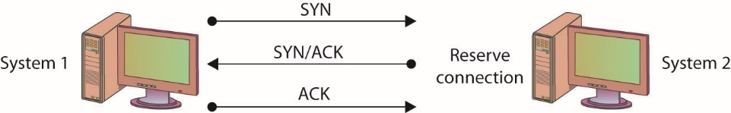
Figure 15.1 The TCP three-way handshake
Notes:
SYN flooding is an example of a DoS attack that takes advantage of the way TCP/IP networks were designed to function, and it can be used to illustrate the basic principles of any DoS attack. SYN flooding uses the TCP three-way handshake that establishes a connection between two systems. Under normal circumstances, the first system sends a SYN packet to the system with which it wants to communicate. The second system responds with a SYN/ACK if it is able to accept the request. When the initial system receives the SYN/ACK from the second system, it responds with an ACK packet, and communication can then proceed. This process is shown in Figure 15.1.

Slide 151
Denial-of-Service Attack (continued)
Steps of a SYN flood attack
Communication request sent to target system.
Target responds to faked IP address.
Target waits for non-existent system response.
Request eventually times out.
If the attacks outpace the requests timing-out, then systems resources will be exhausted.

Slide 152
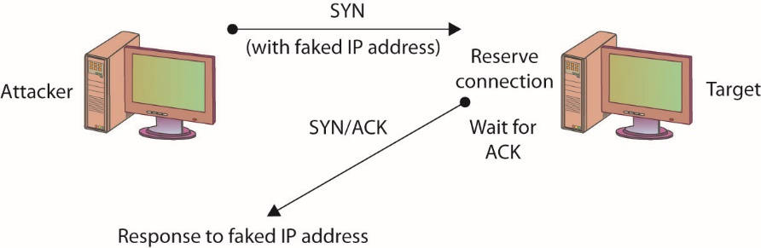
Figure 15.2 A SYN flooding–based DoS attack
Notes:
In a SYN flooding attack, the attacker sends fake communication requests to the targeted system. Each of these requests will be answered by the target system, which then waits for the third part of the handshake. Since the requests are fake (a nonexistent IP address is used in the requests, so the target system is responding to a system that doesn’t exist), the target will wait for responses that never come, as shown in Figure 15.2. The target system will drop these connections after a specific time-out period, but if the attacker sends requests faster than the time-out period eliminates them, the system will quickly be filled with requests. The number of connections a system can support is finite, so when more requests come in than can be processed, the system will soon be reserving all its connections for fake requests. At this point, any further requests are simply dropped (ignored), and legitimate users who want to connect to the target system will not be able to do so, because use of the system has been denied to them.

Slide 153
Denial-of-Service Attack (continued)
Another simple DoS attack is the infamous ping of death (POD).
POD targets a specific application or operating system.
Reminder: SYN flooding targets a protocol.
In the POD attack, the attacker sends an Internet Control Message Protocol (ICMP) ping packet equal to, or exceeding, 64KB.
Certain older systems are not able to handle this size of packet, and the system will hang or crash.

Slide 154
Denial-of-Service Attack (continued)
A DoS attack employing multiple attacking systems is known as a distributed denial-of-service (DDoS) attack.
Denies access or service to authorized users
Uses resources of many systems combined into an attack network
Overwhelms target system or network
With enough attack agents, even simple web traffic can quickly affect a large website
Notes:
Similar to a DoS attack, a Distributed Denial of Service (DDoS) attack has a goal of denying service to authorized users.
The difference between a DoS and DDoS attack centers on the ability of the DDoS to use the combined resources of many systems. An entire network of attack agents can be commandeered and controlled by an attacker.
The combined systems can then overwhelm the target with traffic under the direction of the attacker.
If the attack network is large enough, even simple web traffic can quickly overwhelm even the largest web sites.
A final option you should consider that will address several forms of DoS and DDoS attacks is to block ICMP packets at your border, since many attacks rely on ICMP. Blocking ICMP packets at the border devices prevents external ICMP packets from entering your network, and while this may block some functionality, it will leave internal ICMP functionality intact. It is also possible to block specific forms of ICMP; blocking Type 8, for instance, will block ICMP-based ping sweeps. It is worth noting that not all pings occur via ICMP; some tools, such as hping2, use TCP and UDP to carry ping messages.

Slide 155
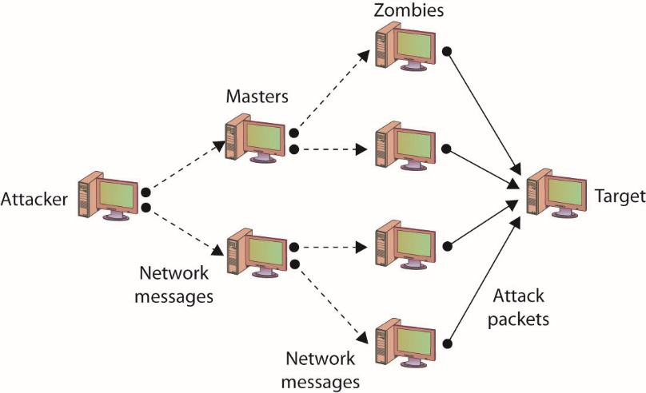
Figure 15.3 DDoS attack
Notes:
Figure 15.3 illustrates a DDoS network with agents and handlers.

Slide 156
Denial-of-Service Attack (continued)
Smurf attack
In a specific DoS attack known as a smurf attack, the attacker sends a spoofed packet to the broadcast address for a network, which distributes the packet to all systems on that network.
Further details are listed in the IP Address Spoofing section.

Slide 157
Denial-of-Service Attack (continued)
Defending against DOS-type attacks
Ensure you have applied the latest patches and upgrades to your systems and the applications running on them.
Change the time-out option for TCP connections so that attacks such as the SYN flooding attack are more difficult to perform.
For DDoS attacks, distribute your workload across several systems.
To prevent a DDoS attack, you must either be able to intercept or block the attack messages or keep the DDoS network from being established in the first place.

Slide 158
Denial-of-Service Attack (continued)
War-dialing is the term used to describe an attacker’s attempt to discover unprotected modem connections to computer systems and networks.
War-dialing was surprisingly successful, mostly because of rogue modems—unauthorized modems attached to computers on a network by authorized users.
War-driving is the unauthorized scanning for and connecting to wireless access points.
Frequently done while driving near a facility
Notes:
War-dialing is an attempt by an attacker to find unprotected modem connections to an organizations computer systems and networks.
Success is often the result of authorized individuals connecting unauthorized or rogue modems to the network. The authorized user’s intent is not usually malicious, but the results can be.
In recent years, advances in telephone firewalls have severely restricted unauthorized connections while also increasing the security of authorized modems as well.
The term war-driving refers to attackers wandering around an area (often in a car), searching for available wireless network connections. There are security measures built into both the hardware and software tasked with maintaining a wireless access point, but it will only operate as well as it is configured.

Slide 159
Social Engineering
Social engineering relies on lies and misrepresentation, which an attacker uses to trick an authorized user into providing information or access the attacker would not normally be entitled to.
Social engineering examples include:
Contacting a system administrator and pretending to be an authorized user, asking to have a password reset
Posing as a representative from a vendor who needs temporary access to perform some emergency maintenance
Notes:
The attacker might, for example, contact a system administrator and pretend to be an authorized user, asking to have a password reset. Another common ploy is to pose as a representative from a vendor who needs temporary access to perform some emergency maintenance. Social engineering also applies to physical access. Simple techniques include impersonating pizza or flower delivery personnel to gain physical access to a facility.
Attackers know that, due to poor security practices, if they can gain physical access to an office, the chances are good that, given a little unsupervised time, a user ID and password pair might be found on a notepad or sticky note.

Slide 160
Null Sessions
Microsoft Windows systems prior to XP and Server 2003 exhibited a vulnerability in their Server Message Block (SMB) system that allowed users to establish null sessions.
A null session is a connection to a Windows inter-process communications share (IPC$).
The good news is that Windows XP, Server 2003, and beyond are not susceptible to this vulnerability by default.

Slide 161
Sniffing
Sniffing is when someone examines all the network traffic that passes their NIC, whether addressed for them or not.
A network sniffer is a software or hardware device.
The device can be used to view all traffic, or it can target a specific protocol, service, or even string of characters.
Sniffers may be able to modify some or all traffic in route
Network administrators can use a sniffer to monitor and troubleshoot network performance.
Notes:
The group of protocols that makes up the TCP/IP suite was designed to work in a friendly environment in which everybody who connected to the network used the protocols as they were designed. The abuse of this friendly assumption is illustrated by network-traffic sniffing programs, sometimes referred to as sniffers.
Sniffing occurs when someone examines all the network traffic that passes their NIC, whether addressed for them or not.
A network sniffer is a software or hardware device that is used to observe traffic as it passes through a network on shared broadcast media.
Sniffing can be used to view all traffic, or it can target a specific protocol, service, or even string of characters (looking for logins, for example).
Some network sniffers are designed not just to observe all traffic but to modify traffic as well.
Network sniffing is more difficult in switched network environments due to the way collision domains are eliminated in full-duplex switching, but certain techniques can be used (spanning ports, ARP poisoning, and attacks forcing a switch to fail and act as a hub) to circumvent this.
Network sniffers can be used by network administrators to monitor network performance.
Network sniffers can be used by attackers to gather information that can be used in penetration attempts.
For network sniffers to be most effective, they need to be on the internal network, which generally means that the chances for outsiders to use them against you are extremely limited.

Slide 162
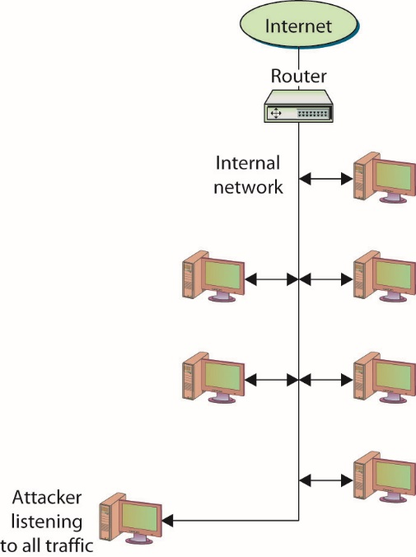
Figure 15.4 Network sniffers listen to all network traffic.
Notes:
Normally, the network device that connects a computer to a network is designed to ignore all traffic that is not destined for that computer.
Network sniffers ignore this friendly agreement and observe all traffic on the network, whether destined for that computer or others, as shown in Figure 15.4.

Slide 163
Spoofing
Spoofing is nothing more than making data look like it has come from a different source.
Spoofing is possible in TCP/IP because of the friendly assumptions behind the protocols.
Protocol assumed that individuals who had access to the network layer would be privileged users who could be trusted.
Notes:
Spoofing is nothing more than making data look like it has come from a different source. This is possible in TCP/IP because of the friendly assumptions behind the protocols. When the protocols were developed, it was assumed that individuals who had access to the network layer would be privileged users who could be trusted.
When a packet is sent from one system to another, it includes not only the destination IP address and port but the source IP address as well. You are supposed to fill in the source with your own address, but nothing stops you from filling in another system’s address. This is one of the several forms of spoofing

Slide 164
Spoofing (continued)
Spoofing e-mail
Occurs when a message is sent with a From address that differs from that of the sending system.
E-mail spoofing examples
Telnet to port 25 on a mail server – From there, you can fill in any address for the From and To sections of the message, whether or not the addresses are yours or even actually exist.
E-mail spoofing variation – Attackers acquire a URL similar to the URL they want to spoof so that e-mail sent from their system appears to have come from the official site.
Notes:
Spoofing E-Mail
In e-mail spoofing, a message is sent with a From address that differs from that of the sending system. This can be easily accomplished in several different ways using several programs.
Recipients can use several methods to determine whether an e-mail message was sent by the source it claims to have been sent from, but most users do not question their e-mail and will accept as authentic where it appears to have originated.

Slide 165
Spoofing (continued)
IP address spoofing
This occurs when a system inserts a different address in the From portion of the IP packet.
In a specific DoS attack known as a smurf attack, the attacker sends a spoofed packet to the broadcast address for a network, which distributes the packet to all systems on that network.

Slide 166
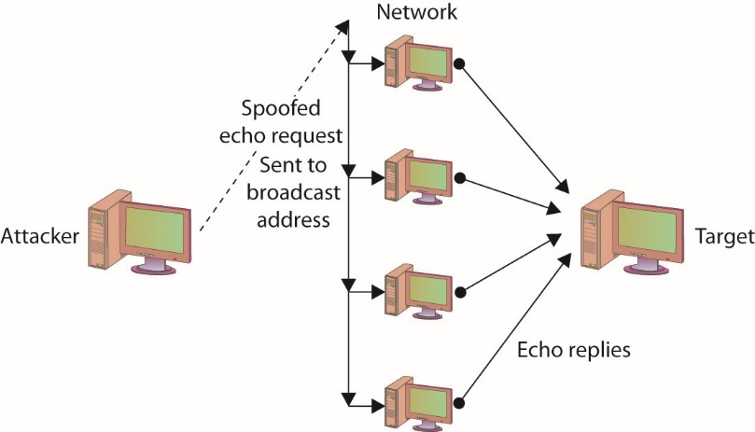
Figure 15.5 Smurfing used in a smurf DOS attack
Notes:
In the smurf attack, the packet sent by the attacker to the broadcast address is an echo request with the From address forged so that it appears that another system (the target system) has made the echo request. The normal response of a system to an echo request is an echo reply, and it is used in the ping utility to let a user know whether a remote system is reachable and is responding. In the smurf attack, the request is sent to all systems on the network, so all will respond with an echo reply to the target system, as shown in Figure 15.5. The attacker has sent one packet and has been able to generate as many as 254 responses aimed at the target. Should the attacker send several of these spoofed requests, or send them to several different networks, the target can quickly become overwhelmed.

Slide 167
Spoofing (continued)
Spoofing and trusted relationships
If two systems are configured to accept the authentication accomplished by each other, an individual logged onto one system might not be forced to go through an authentication process again to access the other system.
An attacker can take advantage of this arrangement by sending a packet to one system that appears to have come from a trusted system.
Since the trusted relationship is in place, the targeted system may perform the requested task without authentication.
Notes:
Spoofing can also take advantage of a trusted relationship between two systems. If two systems are configured to accept the authentication accomplished by each other, an individual logged onto one system might not be forced to go through an authentication process again to access the other system. An attacker can take advantage of this arrangement by sending a packet to one system that appears to have come from a trusted system. Since the trusted relationship is in place, the targeted system may perform the requested task without authentication.

Slide 168
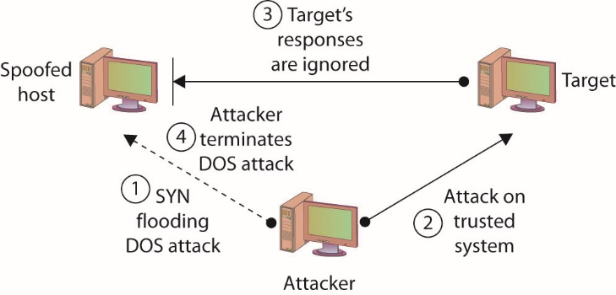
Figure 15.6 Spoofing to take advantage of a trusted relationship
Notes:
Figure 15.6 illustrates a spoofing attack that includes a SYN flooding attack.

Slide 169
Spoofing (continued)
Spoofing and sequence numbers
Formulating packets is more complicated for external attackers because of sequence number.
A sequence number is a 32-bit number established by the host that is incremented for each packet sent.
Packets are not guaranteed to be received in order; the sequence number can be used to help reorder packets.
The difference in the difficulty of attempting a spoofing attack from inside a network and from outside involves determining the sequence number.
Notes:
How complicated the spoofing is depends heavily on several factors, including whether the traffic is encrypted and where the attacker is located relative to the target. Spoofing attacks from inside a network, for example, are much easier to perform than attacks from outside of the network, because the inside attacker can observe the traffic to and from the target and can do a better job of formulating the necessary packets.
Formulating the packets is more complicated for external attackers because a sequence number is associated with TCP packets. A sequence number is a 32-bit number established by the host that is incremented for each packet sent. Packets are not guaranteed to be received in order, and the sequence number can be used to help reorder packets as they are received and to refer to packets that may have been lost in transmission.
The difference in the difficulty of attempting a spoofing attack from inside a network and from outside involves determining the sequence number.
If the attacker is inside of the network and can observe the traffic with which the target host responds, the attacker can easily see the sequence number the system creates and can respond with the correct sequence number.
If the attacker is external to the network and the sequence number the target system generates is not observed, it is next to impossible for the attacker to provide the final ACK with the correct sequence number. So the attacker has to guess what the sequence number might be.

Slide 170
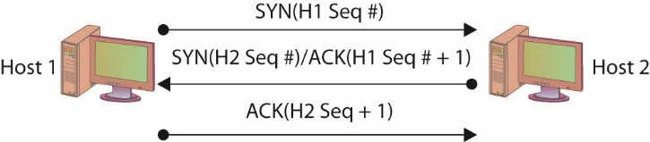
Figure 15.7 Three-way handshake with sequence numbers
Notes:
In the TCP three-way handshake, two sets of sequence numbers are created, as shown in Figure 15.7.
The first system chooses a sequence number to send with the original SYN packet. The system receiving this SYN packet acknowledges with a SYN/ACK. It sends an acknowledgment number back, which is based on the first sequence number plus one (that is, it increments the sequence number sent to it by one). It then also creates its own sequence number and sends that along with it. The original system receives the SYN/ACK with the new sequence number. It increments the sequence number by one and uses it as the acknowledgment number in the ACK packet with which it responds.

Slide 171
TCP/IP Hijacking
TCP/IP hijacking and session hijacking are terms used to refer to the process of taking control of an already existing session between a client and a server.
Attacker does not have to circumvent any authentication mechanisms.
Attack can be disguised with a DoS attack.
Hijack attacks generally are used against web and Telnet sessions.
Notes:
TCP/IP hijacking and session hijacking are terms used to refer to the process of taking control of an already existing session between a client and a server.
The advantage to an attacker of hijacking over attempting to penetrate a computer system or network is that the attacker doesn’t have to circumvent any authentication mechanisms, since the user has already authenticated and established the session.
To prevent the user from noticing anything unusual, the attacker can decide to attack the user’s system and perform a DoS attack on it, taking it down so that the user, and the system, will not notice the extra traffic that is taking place.
Hijack attacks generally are used against web and Telnet sessions. Sequence numbers as they apply to spoofing also apply to session hijacking, since the hijacker will need to provide the correct sequence number to continue the appropriated sessions.

Slide 172
Man-in-the-Middle Attacks
A man-in-the-middle attack generally occurs when attackers are able to place themselves in the middle of two other hosts that are communicating.
Attack is typically accomplished by compromising a router to alter the path of the traffic.
A common method of instantiating a man-in-the-middle attack is via session hijacking.
Session hijacking can occur when information such as a cookie is stolen, allowing the attacker to impersonate the legitimate session.
Can result from a cross-site scripting attack
Notes:
A man-in-the-middle attack generally occurs when attackers are able to place themselves in the middle of two other hosts that are communicating.
A man-in-the-middle attack can be accomplished by compromising a router to alter the path of the traffic.
The attacker can then observe all traffic before relaying it and can actually modify or block traffic.
To the target host, it appears that communication is occurring normally, since all expected replies are received.
There are numerous methods of instantiating a man-in-the-middle attack; one of the common methods is via session hijacking. Session hijacking can occur when information such as a cookie is stolen, allowing the attacker to impersonate the legitimate session. This attack can be as a result of a cross-site scripting attack, which tricks a user into executing code resulting in cookie theft. The amount of information that can be obtained in a man-in-the-middle attack will obviously be limited if the communication is encrypted. Even in this case, however, sensitive information can still be obtained, since knowing what communication is being conducted, and between which individuals, may, in fact, provide information that is valuable in certain circumstances.

Slide 173
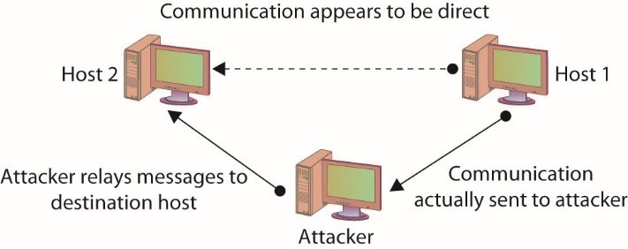
Figure 15.8 A man-in-the-middle attack
Notes:
A man-in-the-middle attack is ideally, accomplished by ensuring that all communication going to or from the target host is routed through the attacker’s host (which can be accomplished if the attacker can compromise the router for the target host). The attacker can then observe all traffic before relaying it and can actually modify or block traffic. To the target host, it appears that communication is occurring normally, since all expected replies are received. Figure 15.8 illustrates this type of attack.

Slide 174
Man-in-the-Middle Attacks (continued)
The term “man-in-the-middle attack” is sometimes used to refer to a more specific type of attack—one in which the encrypted traffic issue is addressed.
An attacker can conduct a man-in-the-middle attack by intercepting a request for a friend’s public key and the sending of your public key to him.
Well-designed cryptographic products use techniques such as mutual authentication to avoid this problem.

Slide 175
Replay Attack
A replay attack occurs when the attacker captures a portion of a communication between two parties and retransmits it at a later time.
Replay attacks are associated with attempts to circumvent authentication mechanisms.
The best way to prevent replay attacks is with encryption, cryptographic authentication, and time stamps.
Notes:
A replay attack occurs when the attacker captures a portion of a communication between two parties and retransmits it at a later time.
Generally replay attacks are associated with attempts to circumvent authentication mechanisms, such as the capturing and reuse of a certificate or ticket.
The best way to prevent replay attacks is with encryption, cryptographic authentication, and time stamps. If a portion of the certificate or ticket includes a date/time stamp or an expiration date/time, and this portion is also encrypted as part of the ticket or certificate, replaying it at a later time will prove useless, since it will be rejected as having expired.

Slide 176
Transitive Access
Transitive access is a means of attacking a system by violating the trust relationship between machines.
A simple example is when servers are well protected and clients are not, and the servers trust the clients.
In this case, attacking a client can provide transitive access to the servers.

Slide 177
Spam
Though not generally considered a social engineering issue, nor a security issue for that matter, spam can, however, be a security concern.
Spam is bulk unsolicited e-mail.
It can be legitimate in the sense that it has been sent by a company advertising a product or service.
Spam can also be malicious and could include an attachment that contains malicious software designed to harm your system, or a link to a malicious web site that may attempt to obtain personal information from you.
Notes:
Though not generally considered a social engineering issue, nor a security issue for that matter, spam can, however, be a security concern. Spam, as just about everybody knows, is bulk unsolicited e-mail. It can be legitimate in the sense that it has been sent by a company advertising a product or service, but it can also be malicious and could include an attachment that contains malicious software designed to harm your system, or a link to a malicious web site that may attempt to obtain personal information from you.

Slide 178
Spim
Though not as well known, a variation on spam is spim, which is basically spam delivered via an instant messaging application such as Yahoo! Messenger or AOL Instant Messenger (AIM).
The purpose of hostile spim is the same as that of spam—the delivery of malicious content or links.

Slide 179
Phishing
Phishing is the use of fraudulent e-mails or instant messages that appear to be genuine but are designed to trick users.
The goal of a phishing attack is to obtain from the user information that can be used in an attack, such as login credentials or other critical information.

Slide 180
Spear Phishing
Spear phishing is the term that has been created to refer to a phishing attack that targets a specific group with something in common.
By targeting a specific group, the ratio of successful attacks (that is, the number of responses received) to the total number of e-mails or messages sent usually increases because a targeted attack will seem more plausible than a message sent to users randomly.

Slide 181
Vishing
Vishing is a variation of phishing that uses voice communication technology to obtain the information the attacker is seeking.
Vishing takes advantage of the trust that some people place in the telephone network.
Users are unaware that attackers can spoof (simulate) calls from legitimate entities using voice over IP (VoIP) technology.
Voice messaging can also be compromised and used in these attempts.
Attackers seek to obtain information for identity theft.
Notes:
Generally, the attackers are hoping to obtain credit card numbers or other information that can be used in identity theft. The user may receive an e-mail asking him or her to call a number that is answered by a potentially compromised voice message system. Users may also receive a recorded message that appears to come from a legitimate entity. In both cases, the user will be encouraged to respond quickly and provide the sensitive information so that access to their account is not blocked. If a user ever receives a message that claims to be from a reputable entity and asks for sensitive information, the user should not provide it but instead should use the Internet or examine a legitimate account statement to find a phone number that can be used to contact the entity. The user can then verify that the message received was legitimate or report the vishing attempt.

Slide 182
Pharming
Pharming consists of misdirecting users to fake web sites that have been made to look official.
Users directed to the fake web site as a result of activity such as DNS poisoning or modification of local host.
Once at the fake web site, the user may supply personal information, believing that they are connected to the legitimate site.

Slide 183
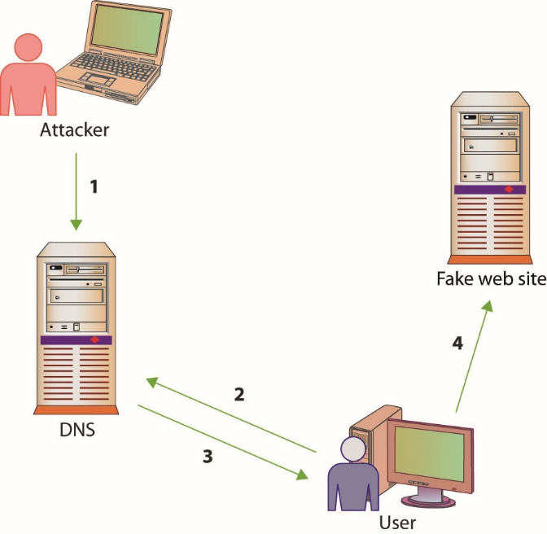
Figure 15.9 How pharming works
Notes:
Figure 15.9 illustrates how pharming operates. The first step is an attacker poisons the DNS system, so when the user queries it (step 2) they get a false address (step 3). This results in the user being directed to the fake web site (step 4).

Slide 184
Scanning Attacks
Scanners can be used to send specifically crafted packets in an attempt to determine TCP/UDP port status.
An XMAS scan uses the URG, PSH, and FIN flags to determine TCP port availability.
If the port is closed, an RST is returned.
If the port is open, there is typically no return.
Advanced firewalls can detect these packets, alerting people to the scanning activities.
Notes:
An XMAS scan can help determine OS type and version, based upon TCP/IP stack responses, and can also help determine firewall rules. These attacks can also be used to consume system resources, resulting in DoS.
Simple stateless firewalls check for the SYN flag set to prevent SYN floods, and Christmas packets are designed not to have SYN set, so they pass right by these devices.

Slide 185
Attacks on Encryption
Encryption is the process of transforming plaintext into an unreadable format known as ciphertext using a specific technique or algorithm.
Most encryption techniques use some form of key in the encryption process.
Cryptanalysis is the process of attempting to break a cryptographic system—it is an attack on the specific method used to encrypt the plaintext.
Cryptographic systems can be compromised in various ways.

Slide 186
Attacks on Encryption (continued)
Certain encryption algorithms may have specific keys that yield poor, or easily decrypted, ciphertext.
An exhaustive search of the keyspace will decrypt the message.
The strength of the encryption method is related to the sheer size of the keyspace.
You cannot immediately compare different key lengths from different algorithms and assume relative strength.

Slide 187
Attacks on Encryption (continued)
One of the most common ways of attacking an encryption system is to find weaknesses in mechanisms surrounding the cryptography.
It is not the cryptographic algorithm itself that is being attacked, but rather the implementation of that algorithm in the real world.

Slide 188
Address System Attacks
IP addresses and other addresses can be manipulated.
DNS kiting, is an economic attack against the terms of using a new DNS entry.
Another twist on this scheme is the concept of domain name front running, where a registrar places a name on a five-day hold after someone searches for it, and then offers it for sale at a higher price.
Notes:
Exam Tip: The process of using a new domain name for the five-day “test” period and then relinquishing the name, only to repeat the process again—in essence, obtaining a domain name for free—is called DNS kiting.

Slide 189
Cache Poisoning
Caches can also be poisoned, sending incorrect information to the end user’s application, redirecting traffic, and changing system behaviors.

Slide 190
Cache Poisoning (continued)
A DNS poisoning attack occurs when network connections are changed, resulting in different DNS lookups.
DNS poisoning can occur at any level.
At times, nslookup will return a nonauthoritative answer.
DNS poisoning is a variant of a larger attack class referred to as DNS spoofing, in which an attacker changes a DNS record through any of a multitude of means.

Slide 191
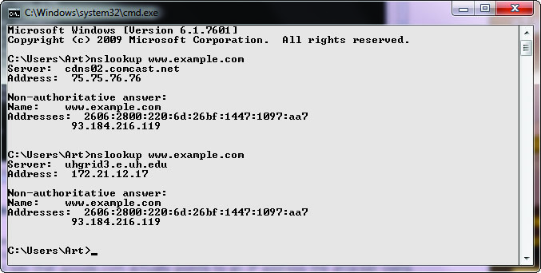
Figure 15.10 nslookup of a DNS query
Notes:
Figure 15.10 shows a series of DNS queries executed on a Windows machine. In the first request, the DNS server was with an ISP, while on the second request, the DNS server was from a VPN connection. Between the two requests, the network connections were changed, resulting in different DNS lookups. This is a form of DNS poisoning attack.

Slide 192
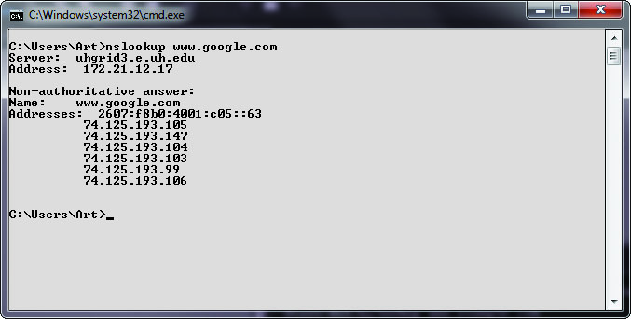
Figure 15.11 Cache response to a DNS query
Notes:
At times, nslookup will return a nonauthoritative answer, as shown in Figure 15.11. This typically means the result is from a cache as opposed to a server that has an authoritative (that is, known to be current) answer.

Slide 193
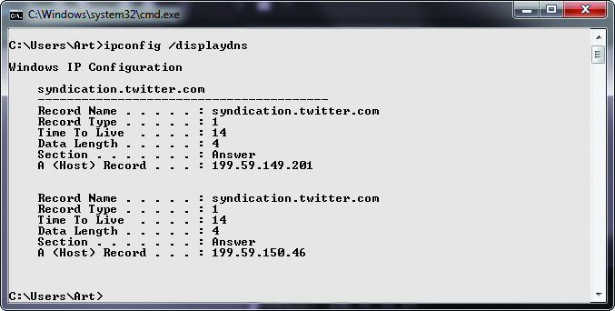
Figure 15.12 Cache response to a DNS table query
Notes:
There are other commands you can use to examine and manipulate the DNS cache on a system. In Windows, the ipconfig/displaydns command will show the current DNS cache on a machine.
Figure 15.12 shows a small DNS cache. This cache was recently emptied using the ipconfig /flushdns command to make it fit on the screen.

Slide 194
Cache Poisoning (continued)
ARP poisoning involves an attacker sending messages, corrupting the ARP table, and causing packets to be misrouted.
This form of attack results in malicious address redirection.
This can allow a mechanism whereby an attacker can inject themselves into the middle of a conversation between two machines, a man-in-the-middle attack.
Local MAC addresses can also be poisoned in the same manner, although it is called ARP poisoning.

Slide 195
Password Guessing
The most common form of authentication is the user ID and password combination
While it is not inherently a poor mechanism for authentication, the combination can be attacked in several ways.
All too often, these attacks yield favorable results for the attacker not as a result of a weakness in the scheme but usually due to the user not following good password procedures.

Slide 196
Password Guessing (continued)
People are notorious for picking poor passwords.
Users need to select a password that they can remember, so they create simple passwords.
The attacker just needs to obtain a valid user ID and some information about the user before guessing can begin.
A password-cracking program can uses a list of dictionary words to try to guess the password.
Rules can also be defined so that the cracking program will substitute special characters for other characters or combine words.

Slide 197
Password Guessing (continued)
In a brute-force attack, a password-cracking program attempts all possible character combinations.
There are two levels of brute-force attack:
Use a password-cracking program to attempt to guess the password directly at a login prompt
Steal a password file and use a password-cracking program to compile a list of possible passwords based on the list of password hashes contained in the password file (offline)
Use narrower list to attempt to guess the password at the login prompt
Notes:
A brute-force attack on a password can take place at two levels:
The attacker can use a password-cracking program to attempt to guess the password directly at a login prompt. The attack can be made more difficult if the account locks after a few failed login attempts.
The attacker can first steal a password file, use a password-cracking program to compile a list of possible passwords based on the list of password hashes contained in the password file (offline), and then use that narrower list to attempt to guess the password at the login prompt. The second attack can be thwarted if the password file is securely maintained so that others cannot obtain a copy of it.

Slide 198
Password Guessing (continued)
A hybrid password attack is an attack that combines the preceding dictionary and brute-force methods.
The birthday attack is a special type of brute-force attack
Uses the birthday paradox that states that in a group of at least 23 people, the chance that two individuals will have the same birthday is greater than 50 percent.
Mathematically, the equation is 1.25×k^{1/2}, where k equals the size of the set of possible values, which in the birthday paradox is 365
Notes:
The birthday attack phenomenon applies to passwords, with k (number of passwords) being quite a bit larger.

Slide 199
Pass-the-Hash Attacks
Pass the hash is a hacking technique where the attacker captures the hash used to authenticate a process.
The attacker can then use this hash by injecting it into a process in place of the password.
This is a highly technical attack, targeting the Windows authentication process, injecting a copy of the password hash directly into the system.
The attacker does not need to know the password.
Notes:
The attacker does not need to know the password, but instead can use a captured hash and inject it directly, which will verify correctly, granting access. As this is a very technically specific hack, tools have been developed to facilitate its operation.

Slide 200
Software Exploitation
Software exploitation is an attack that takes advantage of bugs or weaknesses in software.
Can be the result of poor design, poor testing, or poor coding practices
Can result from what are sometimes called “features”
A preventable problem
Fuzzing: the automated process of applying large sets of inputs to a system and analyzing the output to determine exploitable weaknesses
Can exploit error messages from applications

Slide 201
Software Exploitation (continued)
A common weakness that has often been exploited is a buffer overflow, which occurs when a program is provided more data for input than it was designed to handle.
An integer overflow is a programming error condition that occurs when a program attempts to store a numeric value, an integer, in a variable that is too small to hold it.

Slide 202
Client-Side Attacks
The web browser has become the major application for users to engage resources across the Web.
The popularity and the utility of this interface has made it a prime target for attackers to gain access and control over a system.
A wide variety of attacks can occur via a browser, typically resulting from a failure to validate input properly before use.
Unvalidated input can result in a series of injection attacks, header manipulation, and others.

Slide 203
Client-Side Attacks (continued)
SQL injection attacks and command injection attacks can provide attackers with unauthorized access.
When HTTP is being dynamically generated through the use of user inputs, unvalidated inputs can give attackers an opportunity to change HTTP elements.
When user-supplied information is used in a header, it is possible to deploy a variety of attacks, including cache poisoning, cross-site scripting, cross-user defacement, page hijacking, cookie manipulation, and open redirect.

Slide 204
Client-Side Attacks (continued)
Typo squatting is an attack form that involves capitalizing upon common typo errors.
This attack pattern is also referred to as URL hijacking, fake URL, or brandjacking if the objective is to deceive based on branding.
A drive-by download attack automatically downloads malware within browser, whether a user clicks or not.

Slide 205
Client-Side Attacks (continued)
Attackers can plant malware at sites where users are likely to frequent.
Watering hole attacks involve the infecting of a target web site with malware.
These are not simple attacks, yet they can be very effective at delivering malware to specific groups of end users.
Watering hole attacks are complex to achieve and appear to be backed by nation-states and other high-resource attackers.

Slide 206
Advanced Persistent Threat
The advanced persistent threat (APT) is a method of attack that primarily focuses on stealth and continuous presence on a system.
APT is a very advanced method, requiring a team to maintain access and typically involves high-value targets.
APT typically involves specially crafted attack vectors, coupled with phishing or spear phishing for the initial entry.
Then techniques are employed to develop backdoors and multiple account access routes.

Slide 207
Remote Access Trojans
Remote access Trojans (RATs) are malware designed to enable remote access to a machine.
Similar to remote desktop administration, but rather than being visible to a user, it is hidden in the system.
RATs enable attackers to have a way back into a system.
The principal use of a RAT is to enable re-entry to a system and/or collect data on a system.
A key function of a RAT is to provide a periodic beacon out, so even if firewalls and other security devices block unrequested packets, the beacon function makes them requested, bypassing many security checks.

Slide 208
Tools
There are a variety of toolsets used by security professionals that could also be used for malicious purposes.
These toolsets are used by penetration testers when testing the security posture of a system.
The same tools in the hands of an adversary can be used for malicious purposes.

Slide 209
Metasploit
Metasploit is a framework that enables attackers to exploit systems (bypass controls) and inject payloads (attack code) into a system.
Metasploit is widely distributed, powerful, and one of the most popular tools used by attackers.
When new vulnerabilities are discovered in systems, Metasploit exploit modules are quickly created in the community, making this tool the go-to tool for most professionals.

Slide 210
BackTrack/Kali
BackTrack is a Linux distribution that is preloaded with many security tools.
The current version is called Kali Linux.
It includes a whole host of preconfigured, preloaded tools, including Metasploit, Social-Engineering Toolkit, and others.

Slide 211
Social-Engineering Toolkit
The Social-Engineering Toolkit (SET) is a set of tools that can be used to target attacks toward the people using systems.
It has applets that can be used to create phishing e-mails, Java attack code, and other social engineering–type attacks.
The SET is included in BackTrack/Kali and other distributions.

Slide 212
Cobalt Strike
Cobalt Strike is a powerful application that can replicate advanced threats and assist in the execution of targeted attacks on systems.
Cobalt Strike expands the Armitage tool’s capabilities, adding advanced attack methods.

Slide 213
Core Impact
Core Impact is an expensive commercial suite of penetration test tools.
It has a wide spectrum of tools and proven attack abilities across an enterprise.
Although expensive, the level of automation and integration makes this a powerful suite of tools.

Slide 214
Burp Suite
Burp Suite began as a port scanner tool with limited additional functionality in the arena of intercepting proxies, web application scanning, and web-based content.
Burp Suite is a commercial tool, but it is reasonably priced and well liked and utilized in the pen-testing marketplace.

Slide 215
Auditing
Auditing in the computer security world is a process of assessing the security state of an organization compared against an established standard.
Auditing should be conducted on a regular basis.
Audits differ from security or vulnerability assessments.
Auditing can be contracted out to a another party.
An assessment should include:
Security perimeter
Policies, procedures, and guidelines governing security
Employee training
Notes:
The important elements here are the standards. Organizations from different communities may have widely different standards, and any audit will need to consider the appropriate elements for the specific community. Audits differ from security or vulnerability assessments in that assessments measure the security posture of the organization but may do so without any mandated standards against which to compare them. In a security assessment, general security “best practices” can be used, but they may lack the regulatory teeth that standards often provide. Penetration tests can also be encountered—these tests are conducted against an organization to determine whether any holes in the organization’s security can be found. The goal of the penetration test is to penetrate the security rather than measure it against some standard. Penetration tests are often viewed as white-hat hacking in that the methods used often mirror those that attackers (often called black hats) might use.

Slide 216
Perform Routine Audits
Examples of items that should be audited on a regular basis include:
User access
User rights
Storage
Retention
Firewall rules
Notes:
As part of any good security program, administrators must perform periodic audits to ensure things “are as they should be” with regard to users, systems, policies, and procedures. Installing and configuring security mechanisms is important, but they must be reviewed on a regularly scheduled basis to ensure they are effective, up to date, and serving their intended function. Here are some examples, but by no means a complete list, of items that should be audited on a regular basis:
User access – Administrators should review which users are accessing the systems, when they are doing so, what resources they are using, and so on. Administrators should look closely for users accessing resources improperly or accessing legitimate resources at unusual times.
User rights – When a user changes jobs or responsibilities, she will likely need to be assigned different access permissions; she may gain access to new resources and lose access to others. To ensure that users have access only to the resources and capabilities they need for their current positions, all user rights should be audited periodically.
Storage – Many organizations have policies governing what can be stored on “company” resources and how much space can be used by a given user or group. Periodic audits help to ensure that no undesirable or illegal materials exist on organizational resources.
Retention – In some organizations, how long a particular document or record is stored can be as important as what is being stored. A records retention policy helps to define what is stored, how it is stored, how long it is stored, and how it is disposed of when the time comes. Periodic audits help to ensure that records or documents are removed when they are no longer needed.
Firewall rules – Periodic audits of firewall rules are important to ensure the firewall is filtering traffic as desired and to help ensure that “temporary” rules do not end up as permanent additions to the rule set.

Slide 217
Chapter Summary
Describe the various types of computer and network attacks, including denial-of-service, spoofing, hijacking, and password guessing.
Identify the different types of malicious software that exist, including viruses, worms, Trojan horses, logic bombs, time bombs, and rootkits.
Explain how social engineering can be used as a means to gain access to computers and networks.
Describe the importance of auditing and what should be audited.

